Slide 1
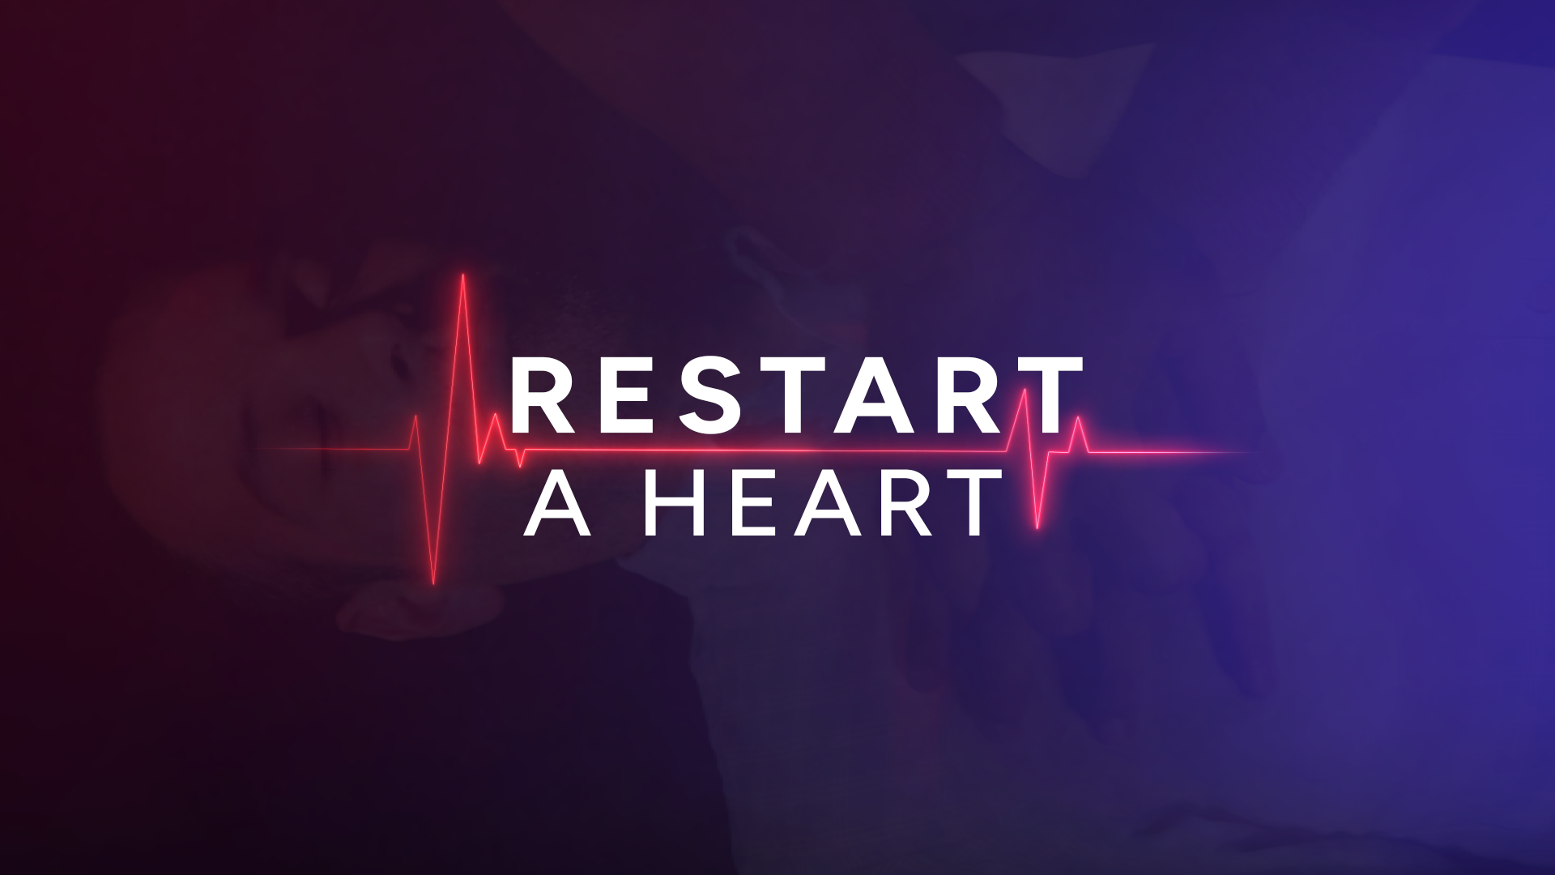
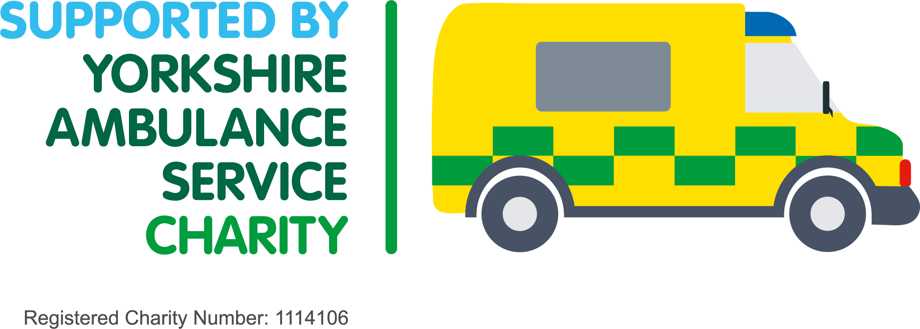
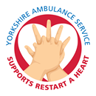

Restart a Heart Day
16 October 2025

Slide 2

Welcome to
Restart a Heart Day 2025
Who am I?
Why am I here?
What is Restart a Heart Day?
Why is it important?
Notes:
Welcome to Restart a Heart Day 2025!​
​
Let’s start with some introductions… ​
​
[WHO AM I?] My name is [name] and I am a [job role]. (Introduce other people if there is more than one volunteer).​
[WHY AM I HERE?] Today, I am here to teach you how to perform CPR – which is a simple life-saving technique to help someone in cardiac arrest. ​
[WHAT IS RESTART A HEART DAY?] Today, is Restart a Heart day! In the last 11 years, on Restart a Heart Day, we have taught over 270,000 young people, such as yourself – how to perform CPR. ​
[WHY IS IT IMPORTANT?] So why is it so important? Well, by performing CPR, you can more than double someone’s chance of survival and potentially save their life.​

Slide 3
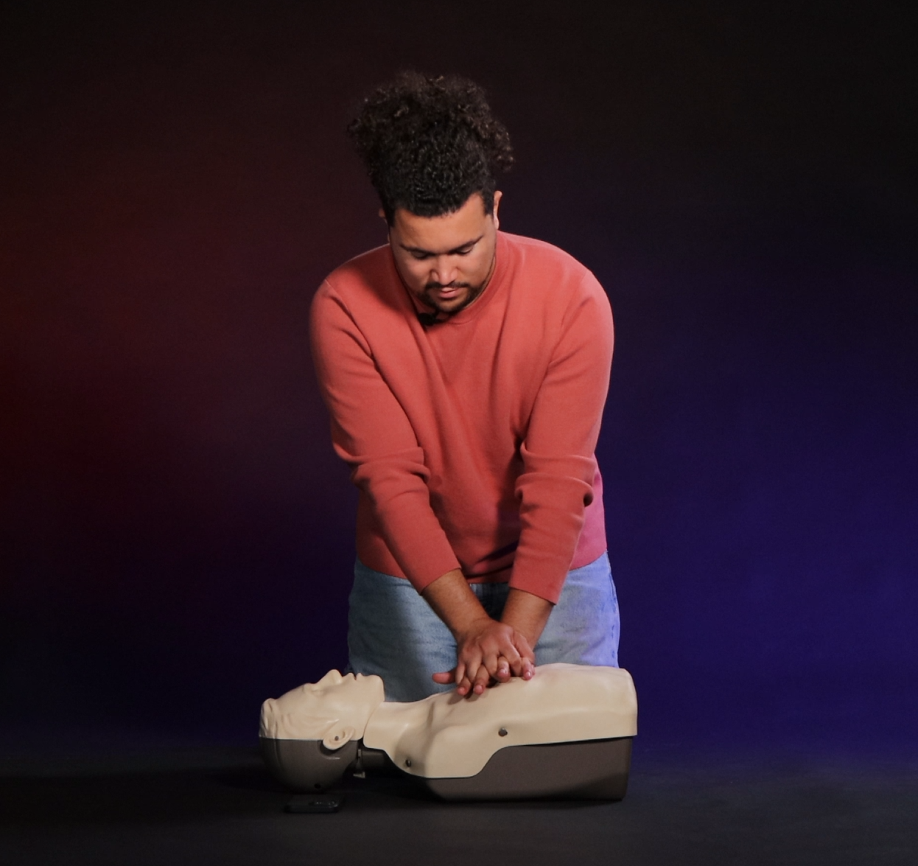
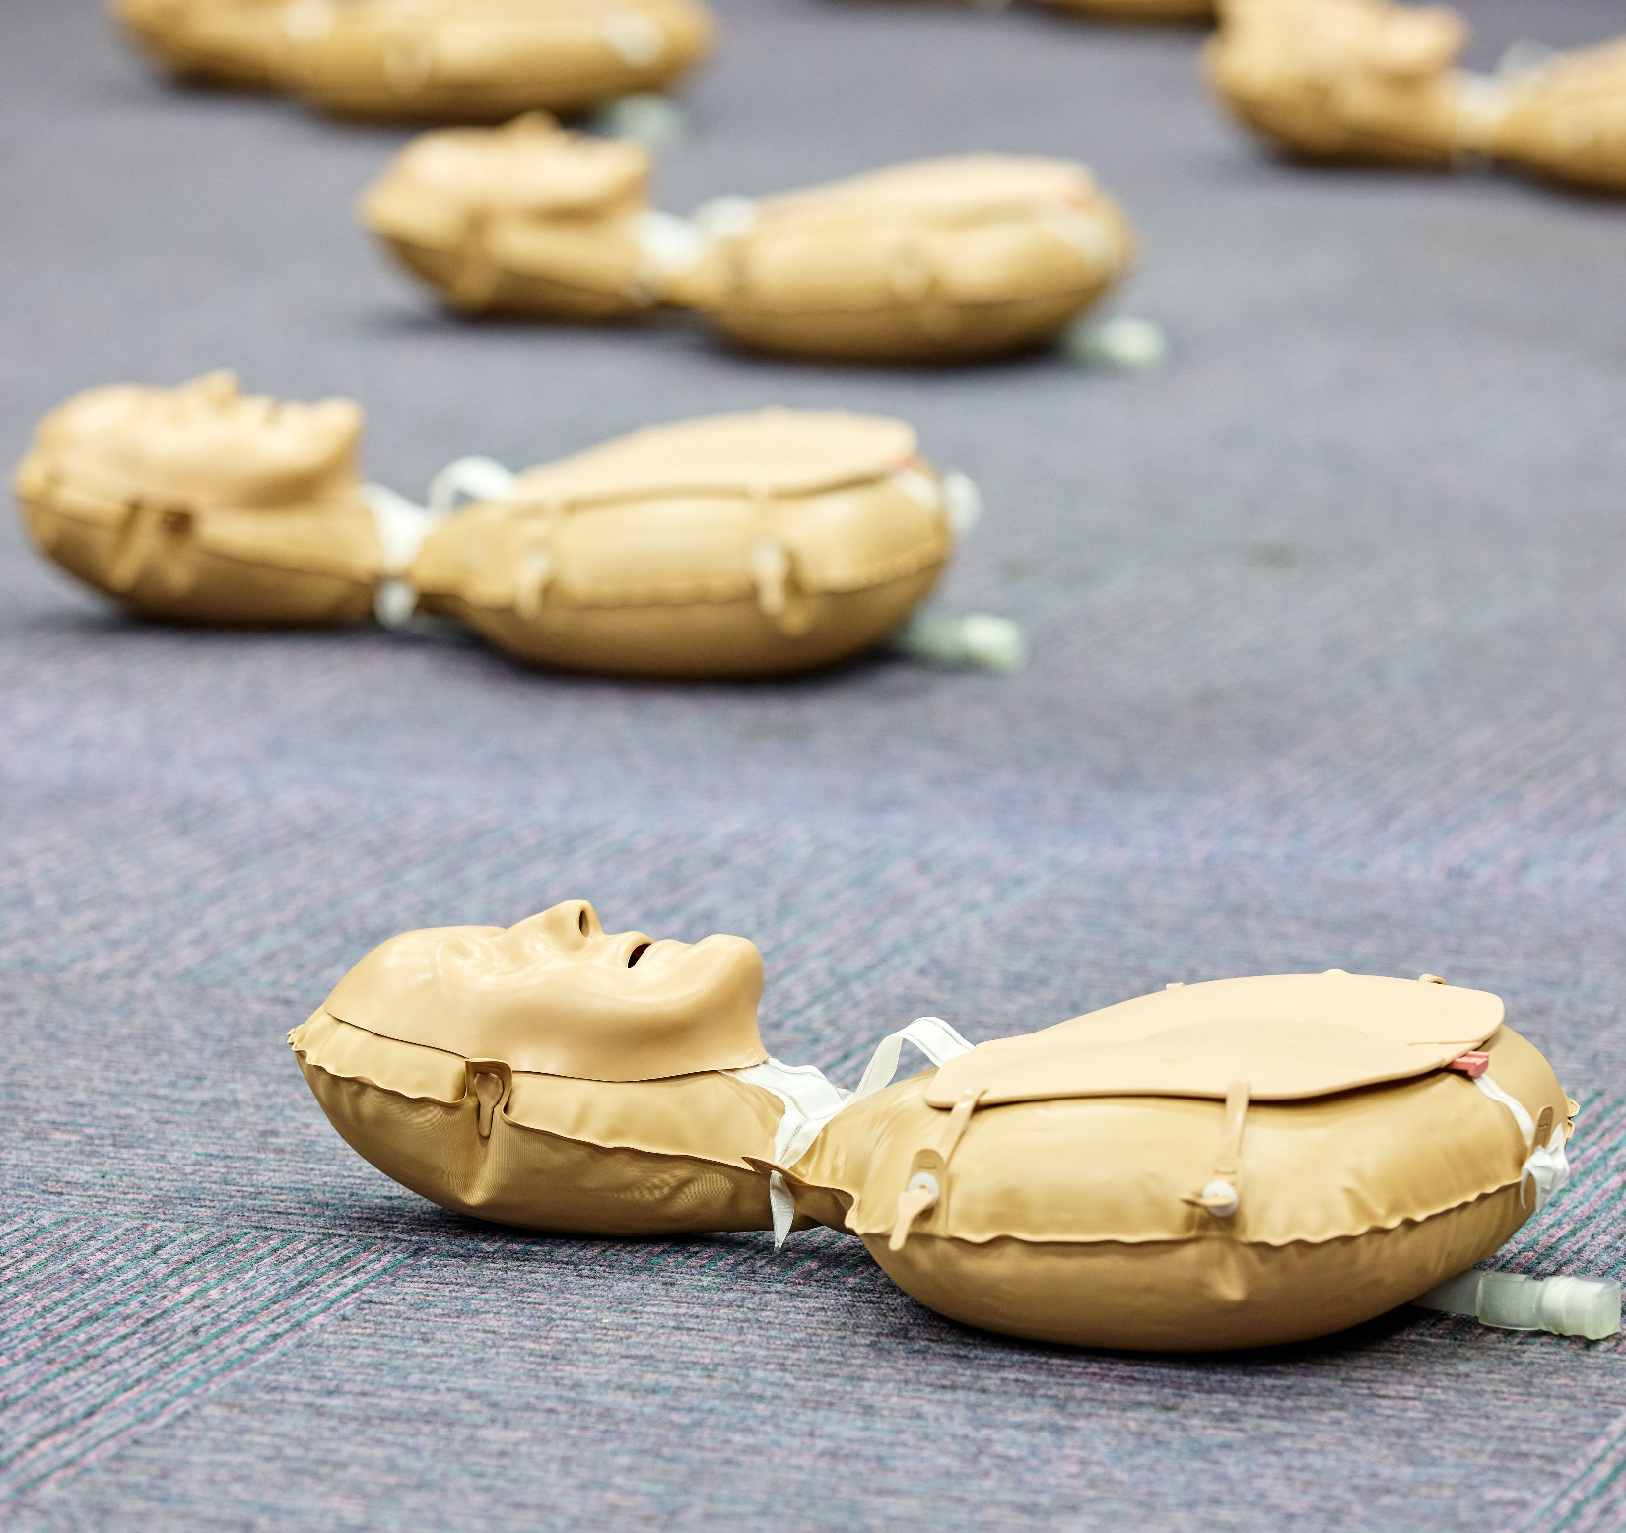
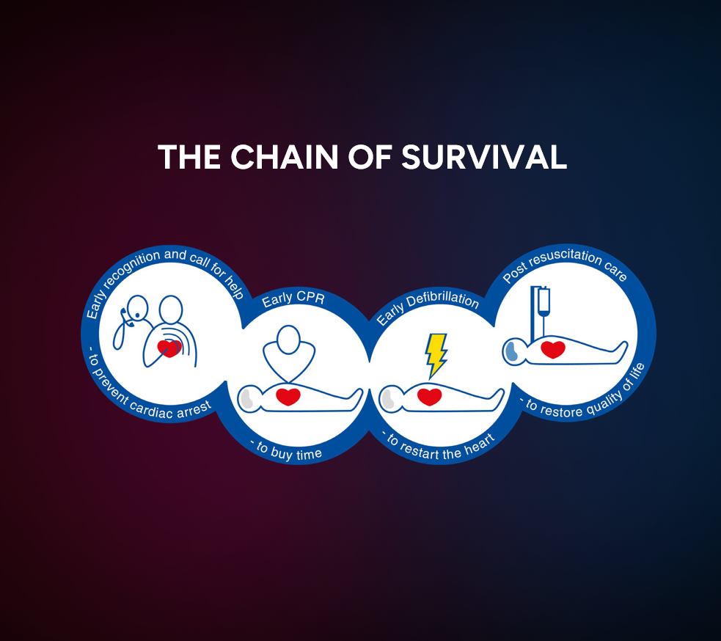
Our plan for today
Watch CPR
training video
Over to you!
Demonstration
Final thoughts
and questions
Notes:
Our plan for today will be to first watch a fantastic CPR training video, which will give you all of the information you need. ​
You will then have a go yourself, with the CPR manikins you can see around the room. We will be here to guide you. ​
Then, we will finish with some final thoughts and answer any questions that you may have. ​

Slide 4
Our plan for today
Restart a Heart CPR video
Notes:
So let’s start with the training video – are you ready? Here we go… ​
(Click on link to play video on You Tube in new window)

Slide 5
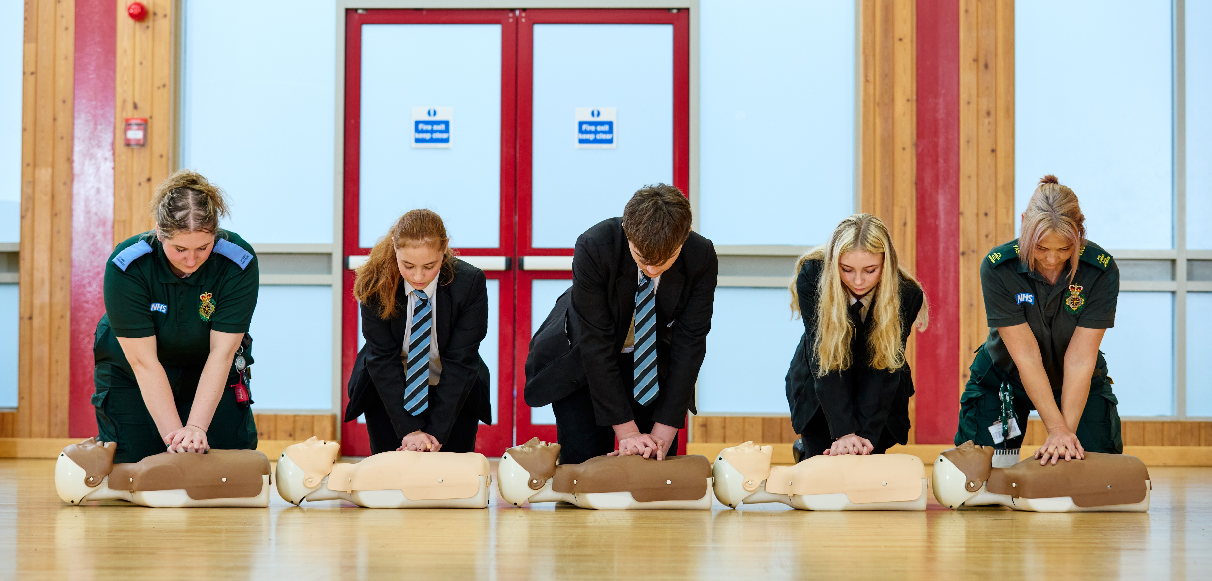
Over to you!
Notes:
Now it is over to you!​
​
[Start physical demonstration]​

Slide 6
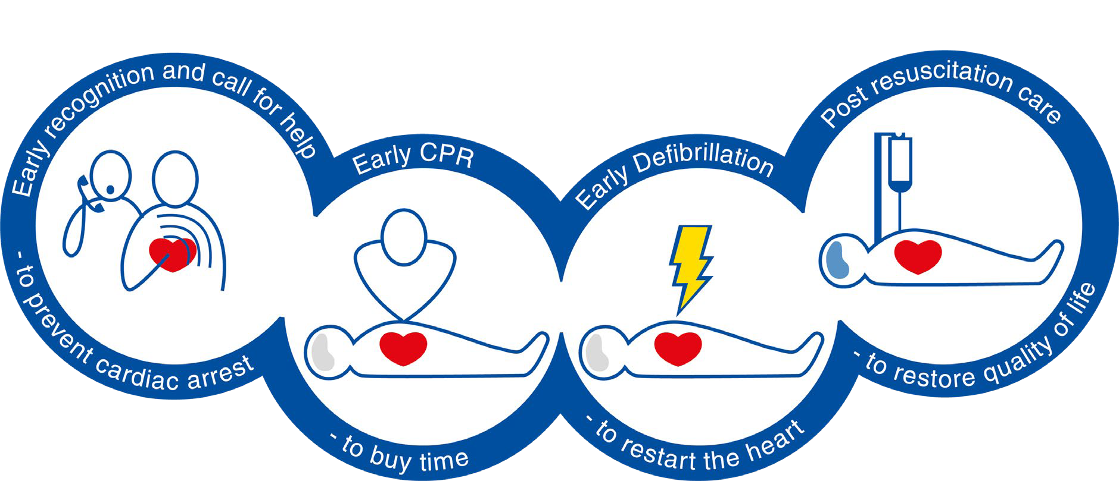
The chain of survival
The Chain of Survival highlights the four essential steps needed to improve the chances of saving a life in an emergency. Crucially, you must call 999 and ask for an ambulance straight away if someone is in cardiac arrest.
Notes:
Well done! You all did a great job.​
​
So just to recap:​
​
This is the Chain of Survival. ​
​
It highlights the four essential steps needed to improve the chances of saving a life in an emergency. ​
First is early recognition and a call for help - to recognise the signs of a cardiac arrest and activate the ambulance service.​
Next is Early CPR – to buy time. ​
Third is Early Defibrillation – to restart the heart. ​
And finally, post-resuscitation care – to restore quality of life.​
​
Crucially, you must call 999 and ask for an ambulance straight away if someone is in cardiac arrest.​
​

Slide 7
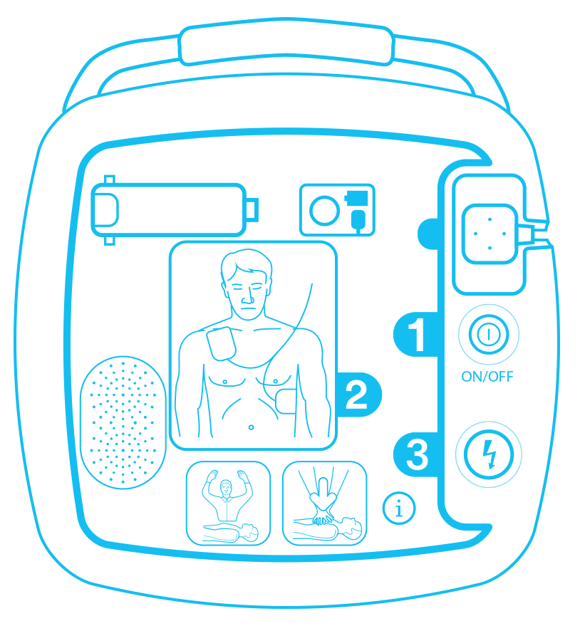
Remember…
80%
Approximately 80% of out-of-hospital cardiac arrests happen in the home. By learning CPR, you are gaining skills that could save the life of a family member or friend. 20% will occur in public places.
If a defibrillator is used and effective CPR is performed within 3-5 minutes of a cardiac arrest, the patient’s chance of survival increases from 6% to 74%.
Notes:
Remember:​
​
Approximately 80% of out-of-hospital cardiac arrests happen in the home. By learning CPR, you are gaining skills that could save the life of a family member or friend. 20% will occur in public places.​
If a defibrillator is used and effective CPR is performed within 3-5 minutes of a cardiac arrest, the patient’s chance of survival increases from 6% to 74%.​
​

Slide 8
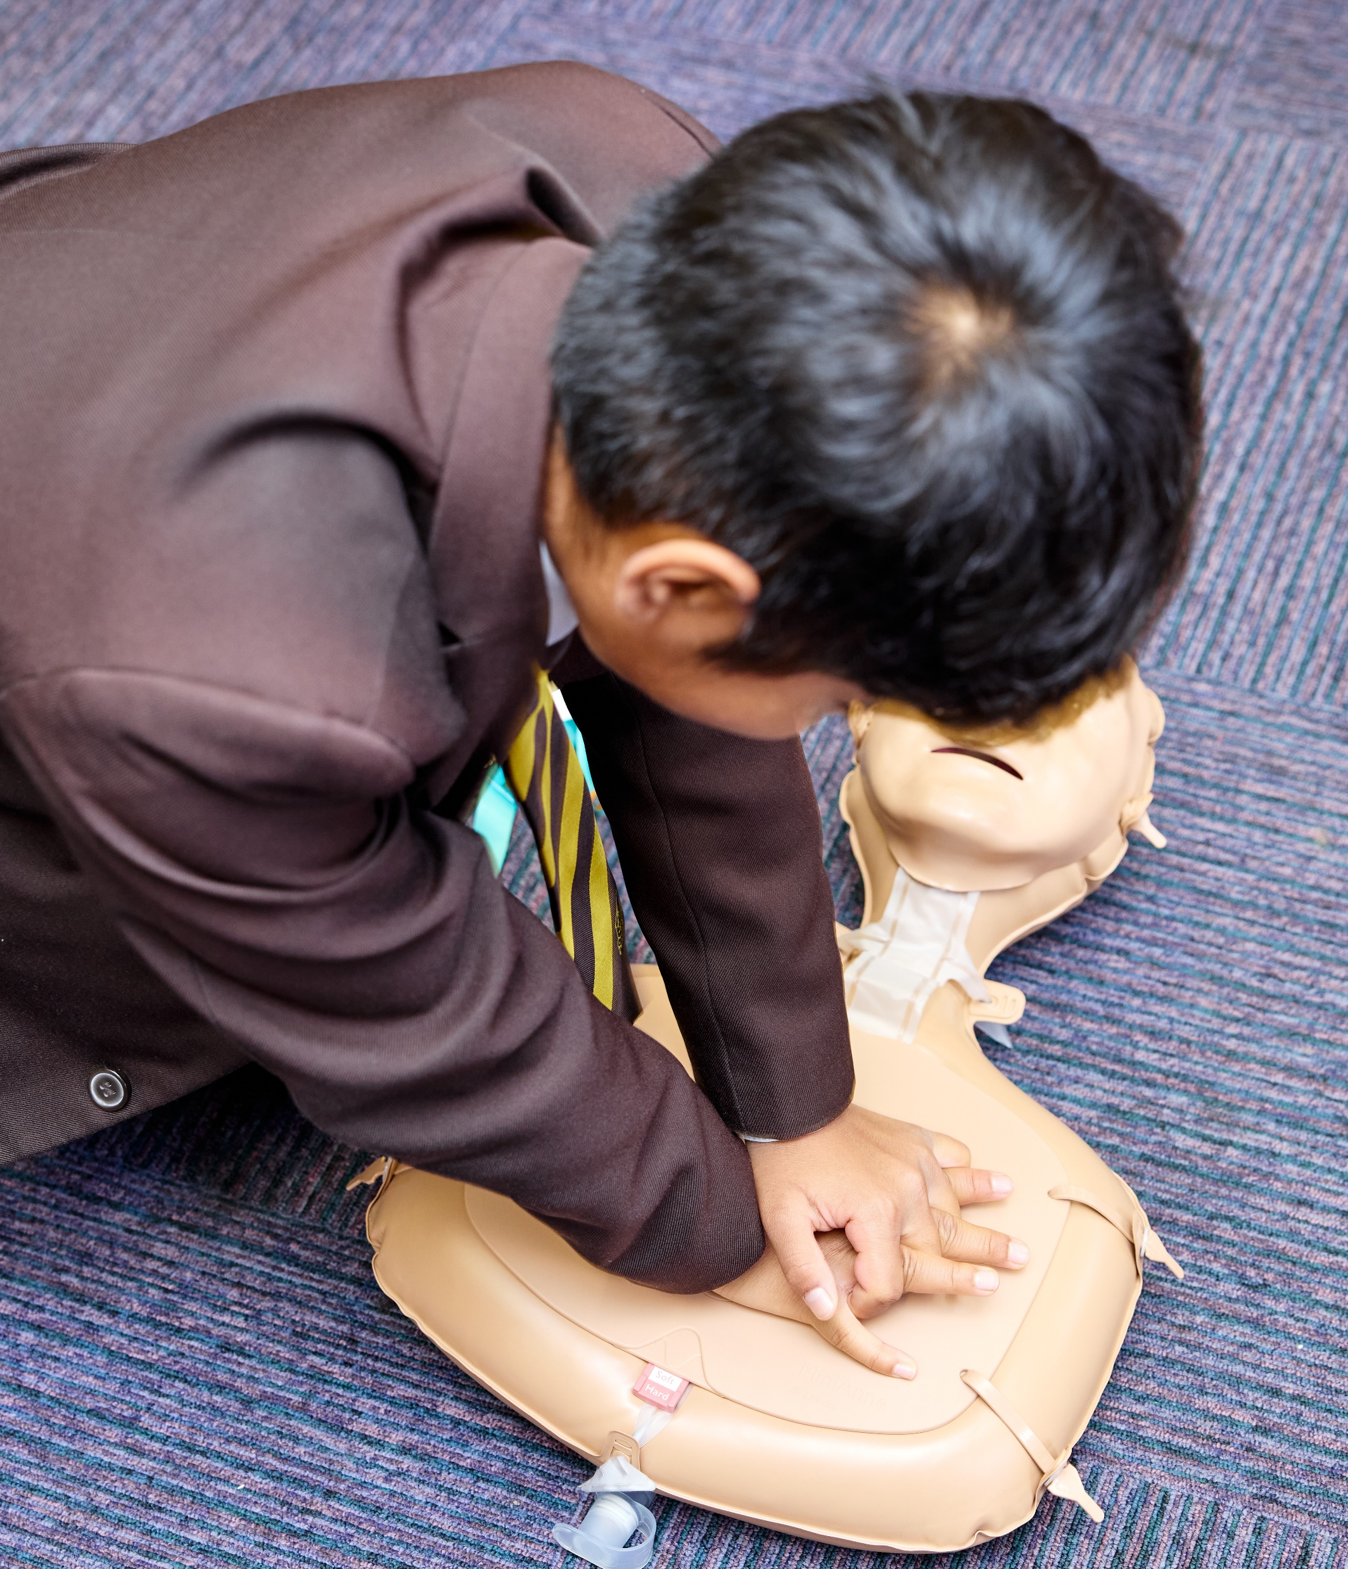


CPR training links
Training resources
Spotify CPR playlist
Notes:
So thinking ahead, the training video, along with other great training resources on CPR are available on our Restart a Heart website - so you can remind yourself of the techniques and maybe even share this training with your family and friends. There is also a CPR playlist you can listen to. These songs have the correct rate for CPR and there may be a song you like in there, which will help you remember the rate. ​

Slide 9
Questions
Do you have any questions?
Notes:
Before we finish, does anyone have any questions you would like to ask? ​

Slide 10
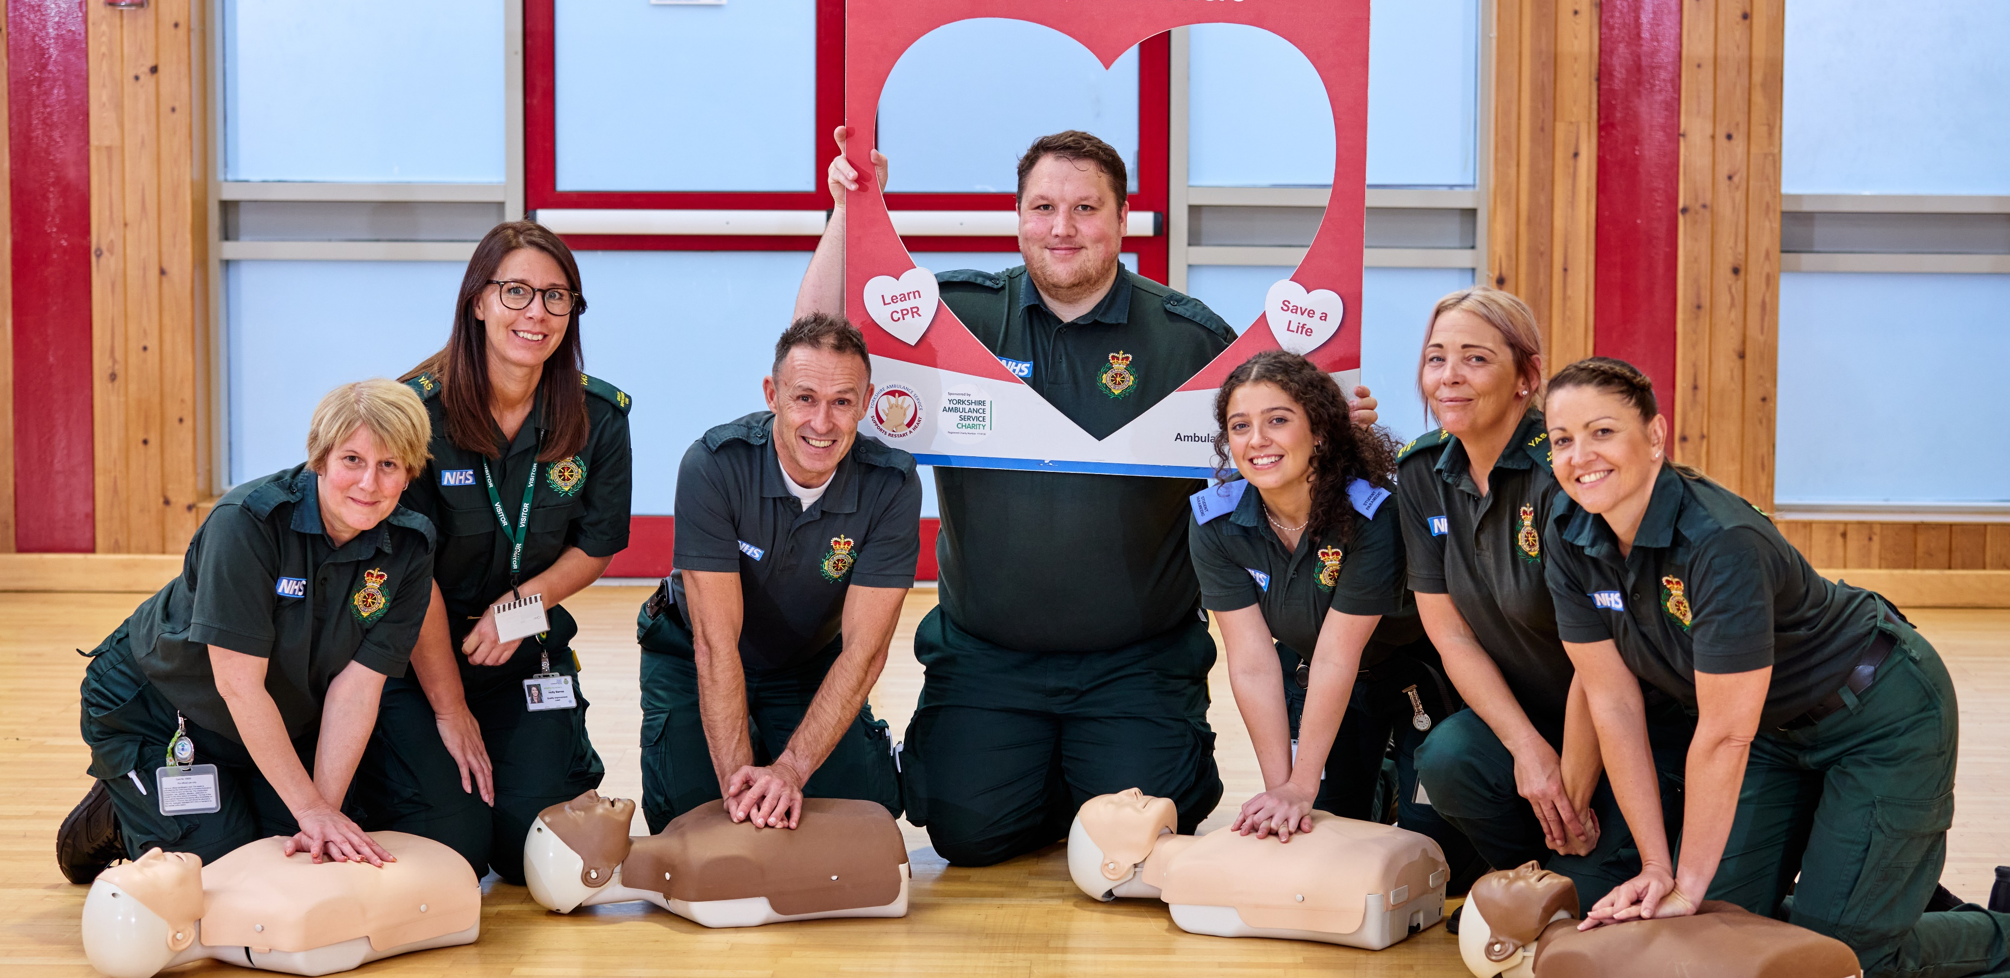
Thank you
Notes:
Thank you all so much for taking part today, I hope you enjoyed the session and feel confident to leave here today, knowing that you now have the skills to potentially save a life. ​
​
If you have any questions, please let me know on your way out.​

