Slide 1
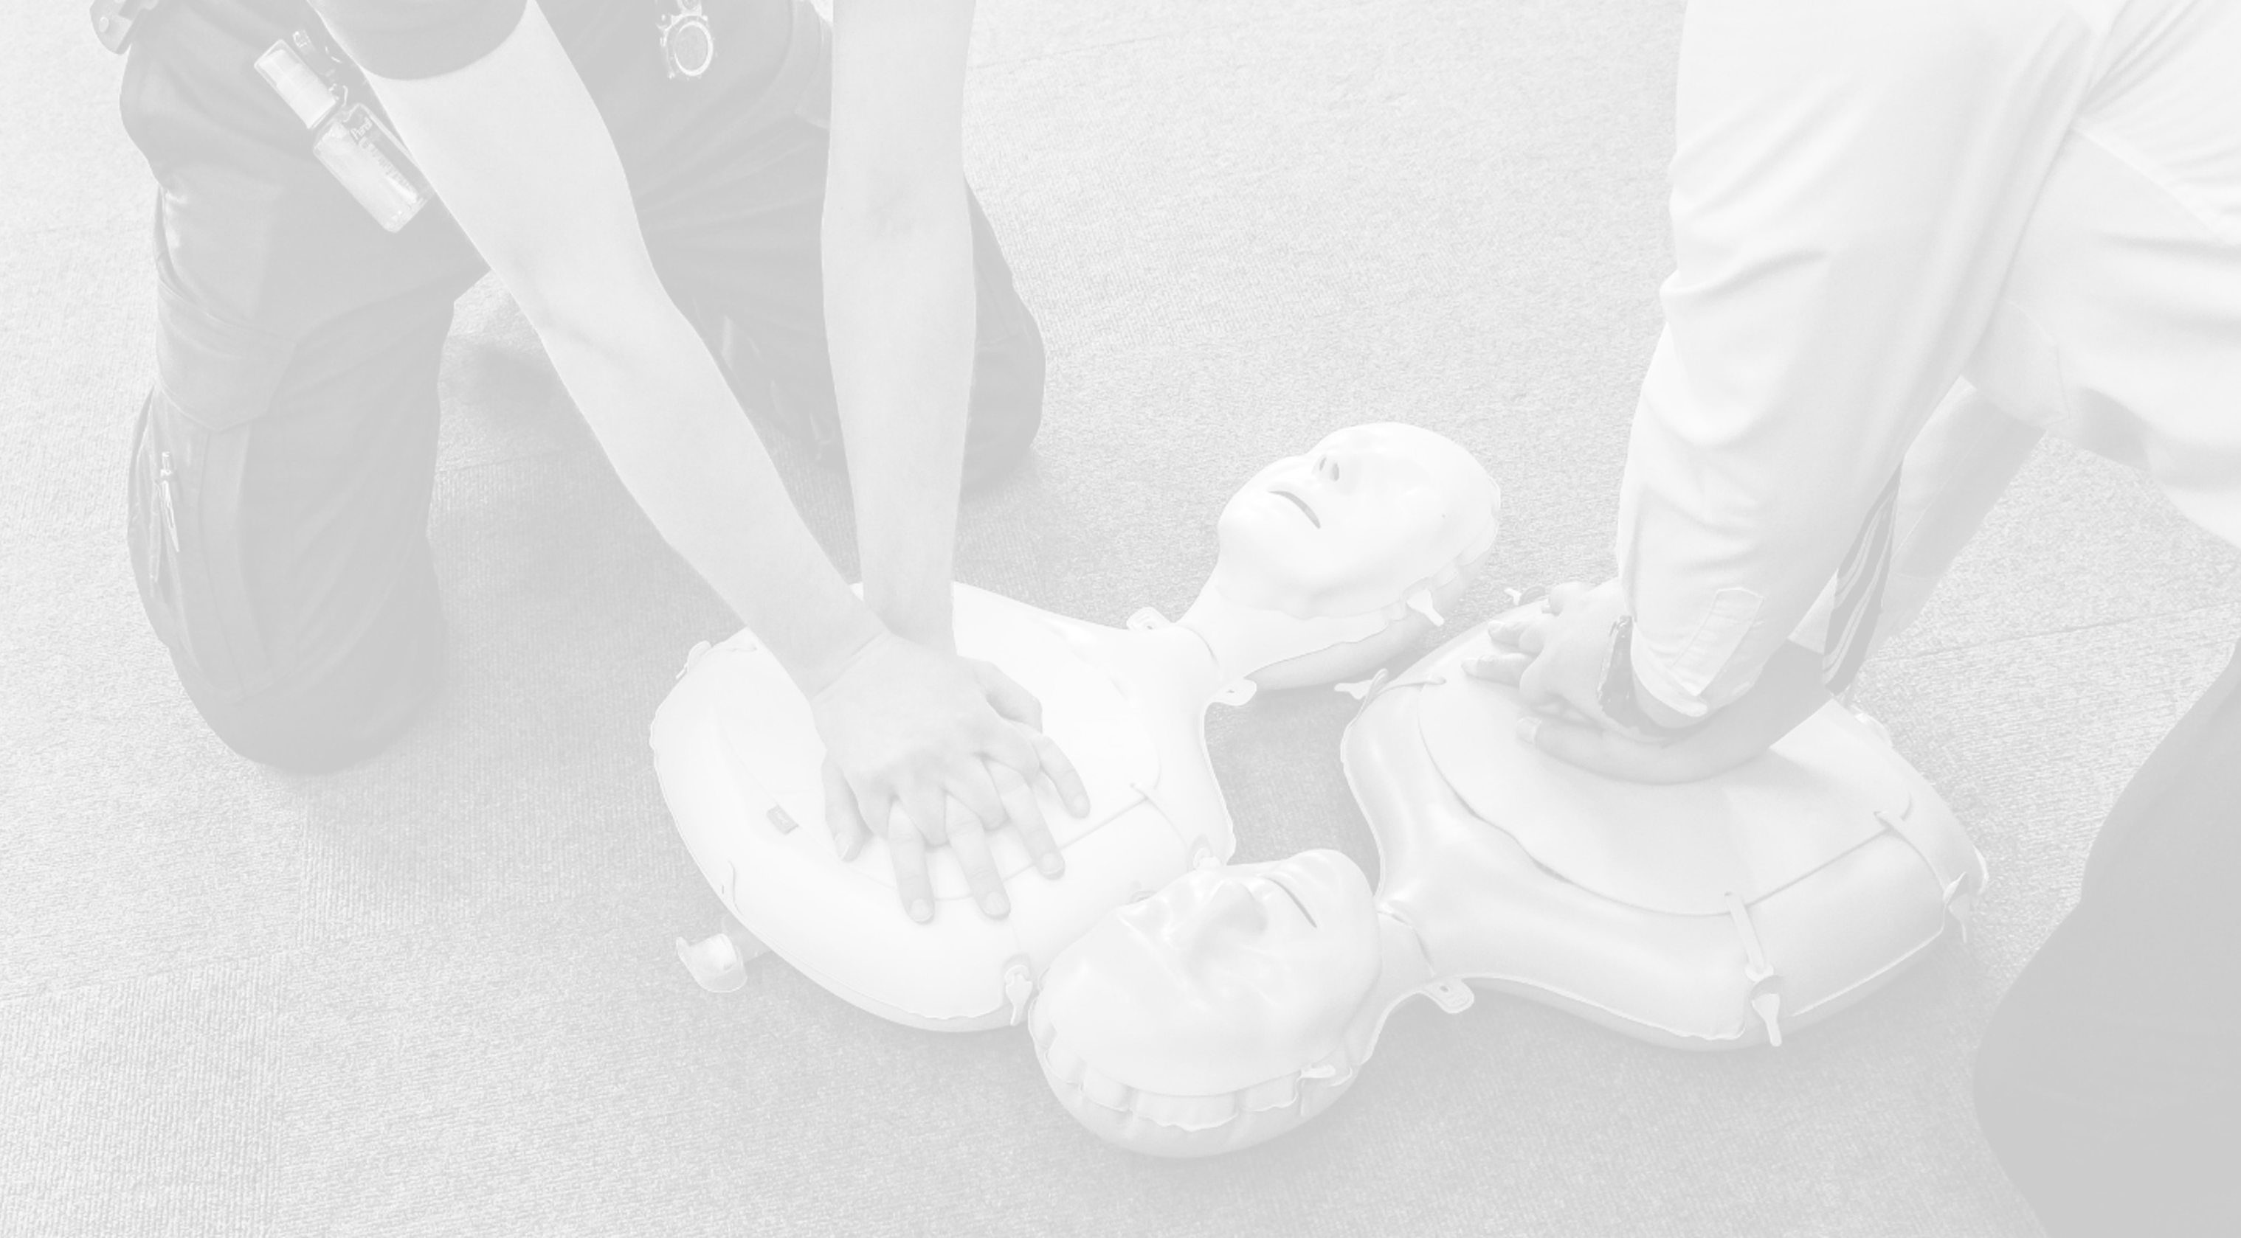
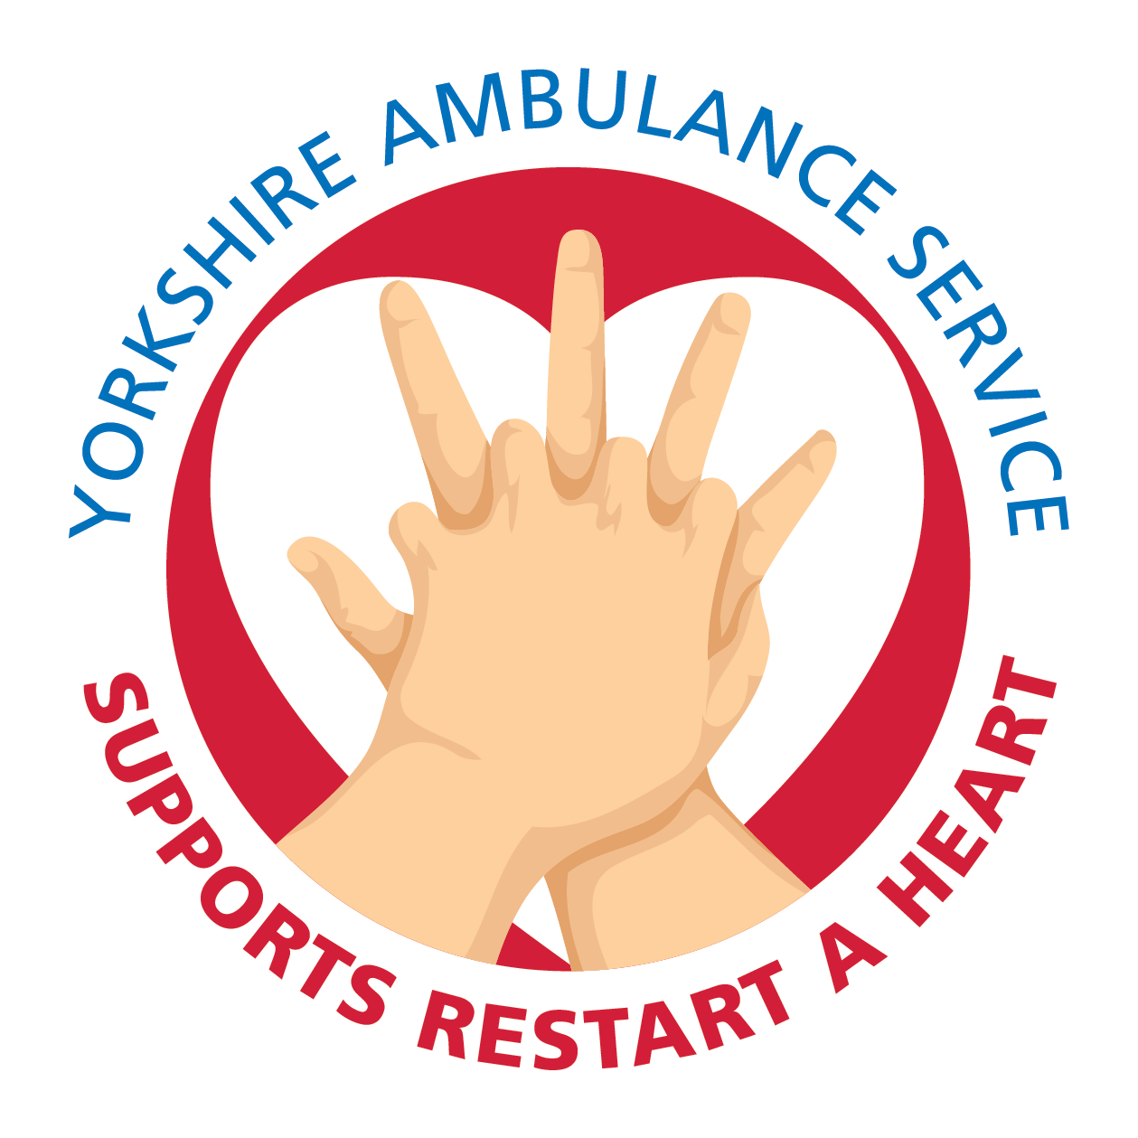
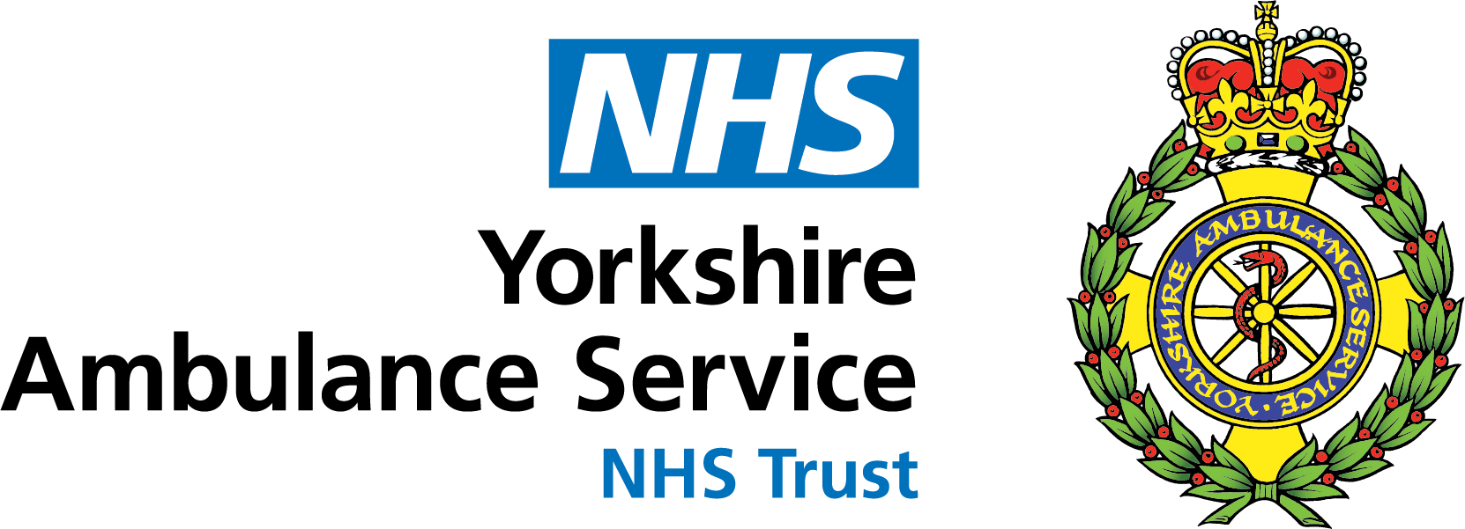
Restart a Heart Day

Slide 2
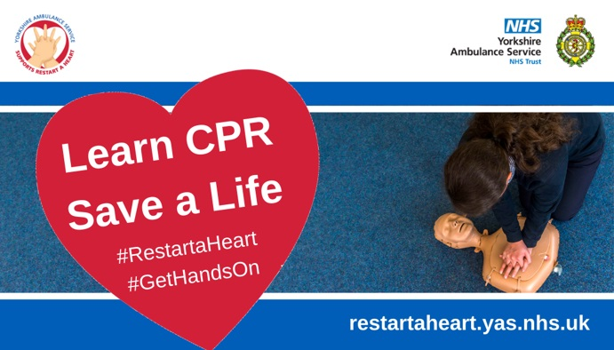
Welcome
Introductions – who are we and why are we here?
What is Restart a Heart Day?
Why is Restart a Heart Day important?
Notes:
Restart a Heart Day was developed in 2013 by the European Resuscitation Council to encourage others to teach members of the public how to help restart the heart of someone who has suffered a cardiac arrest.
Over 30,000 people suffer a cardiac arrest out of hospital in the UK every year. The earlier a patient can receive CPR and a shock from a defibrillator the greater their chance of survival and that’s why we are here today, to teach you how to be a life-saver.

Slide 3
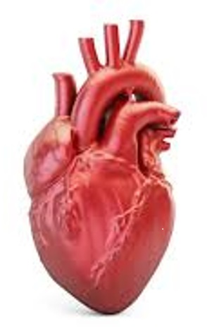
What is a cardiac arrest?
A cardiac arrest is the ultimate medical emergency when someone’s heart stops pumping blood around their body, causing them to collapse and stop breathing normally.
Every year about 30,000 people across the UK have a cardiac arrest outside of hospital.
About 1 in 10 of these patients survive their cardiac arrest but in countries where CPR is taught as part of the school curriculum it is as high as 4 in 10.
Notes:
If a cardiac arrest occurs, blood will stop circulating around the body. Breathing will also cease as well though it may not stop completely for several minutes.Without a supply of oxygen, the cells in the body start to die. Brain cells are incredibly sensitive. After about four or five minutes of no oxygen, brain cells will begin to die, leading to brain damage and death.
All the cells in your body require oxygen to survive. They also require a good supply of nutrients and the rapid removal of waste products. Oxygen and nutrients are carried around the body in your blood, which is pumped by your heart. In your lungs, oxygen enters your blood stream and carbon dioxide (a waste product) is removed in a process known as gas exchange. A cardiac arrest is when your heart stops beating. This is not the same as a heart attack, although a heart attack may lead to a cardiac arrest.

Slide 4
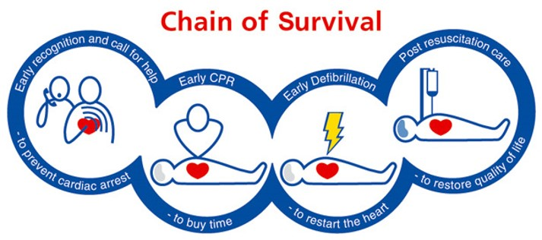
The Chain of Survival
The Chain of Survival highlights the four essential steps needed to improve the chances of saving a life in an emergency. Crucially, you must call 999 and ask for an ambulance straight away if someone is in cardiac arrest.
Notes:
Chain of Survival - Early Recognition, Early CPR, Early Call for Help, Early Defibrillation. A chain is only as strong as its weakest link. Bystander intervention is vital to improve outcomes.
Over 30,000 people suffer cardiac arrests outside hospital in the UK every year. If this happens in front of a bystander who starts CPR immediately before the arrival of the ambulance, the patient’s chances of survival double

Slide 5
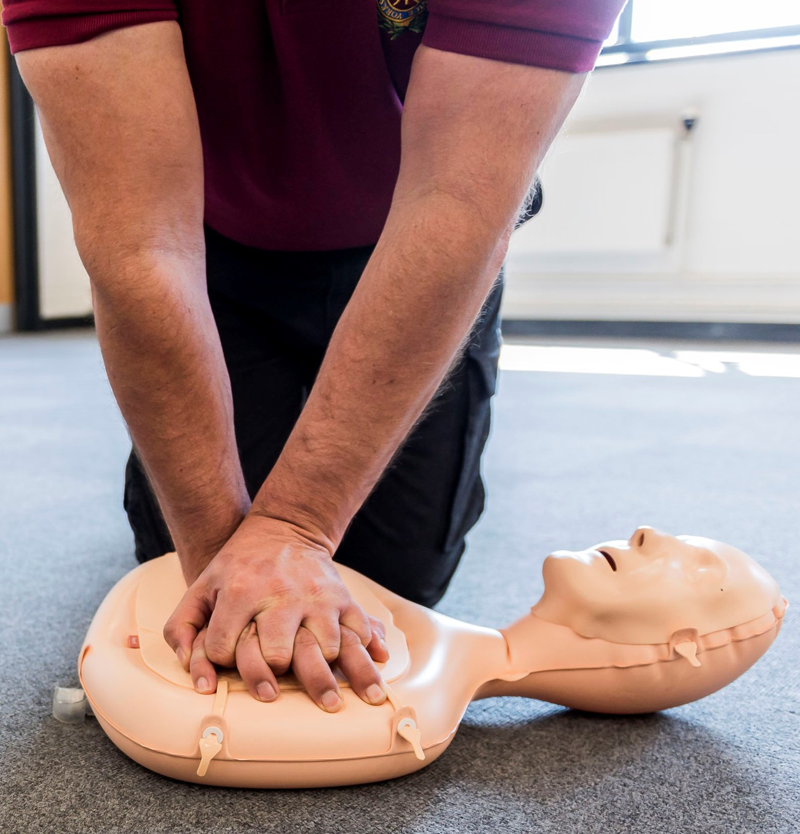
What is CPR?
Cardiopulmonary resuscitation (CPR) is a simple life-saving technique given to someone in cardiac arrest. It aims to take over the job of the heart and lungs by keeping blood and oxygen flowing through the body.
By performing CPR, you can more than double someone’s chances of survival.
Chances of survival decrease by 10% for every minute that passes without CPR.
Notes:
Cardiopulmonary resuscitation (CPR) is a simple life-saving technique given to someone in cardiac arrest. It aims to take over the job of the heart and lungs by keeping blood and oxygen flowing through the body.
A cardiac arrest is caused by an electrical problem in the heart which then stops pumping blood around the body and brain.
CPR incorporates chest compressions (push ‘hard and fast’ in the centre of the chest between the nipples to the beat of ‘Staying Alive’) and rescue breaths (this aspect is not recommended during the COVID-19 pandemic). Without CPR, the person will die within minutes.
The purpose of CPR is to keep oxygenated blood flowing around the body to keep the vital organs alive. CPR itself will not restart someone’s heart, it just keeps them alive until a defibrillator arrives. A defibrillator is a device which delivers an electrical shock to the heart to restart it.

Slide 6
Hands-only CPR
1. Place the heel of your hand on the breastbone at the centre of the person's chest. Place your other hand on top of your first hand and interlock your fingers.
2. Position yourself with your shoulders above your hands. Using your body weight (not just your arms), press straight down by 5 to 6cm (2 to 2.5 inches) on their chest.
3. Keeping your hands on their chest, release the compression and allow the chest to return to its original position.
4. Repeat these compressions at a rate of 100 to 120 times a minute until an ambulance arrives, you become exhausted or the patient starts to show signs of regaining consciousness such as coughing, opening eyes, speaking or breathing.

Slide 7
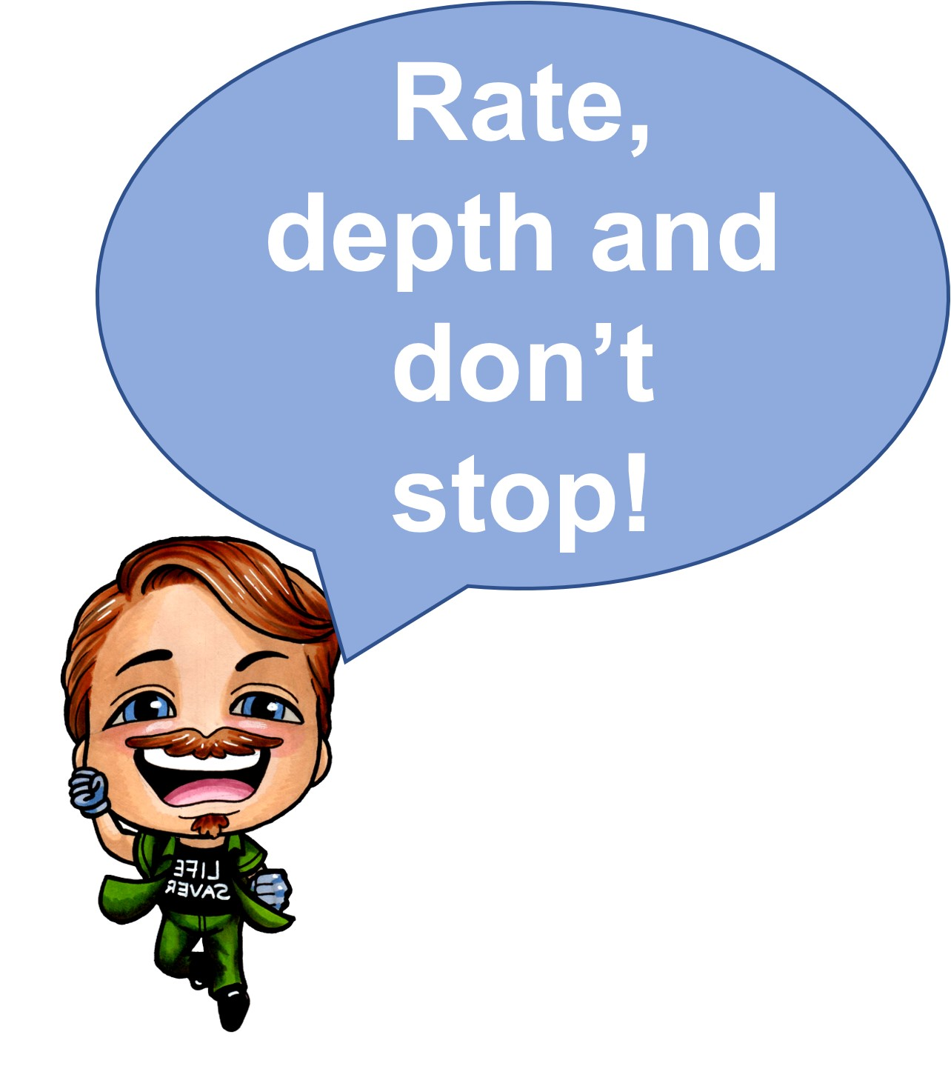
Effective CPR
To make sure your CPR is really effective remember the phrase ‘Rate, Depth and Don’t Stop’
Rate
Compressions at a rate of 100 to 120 per minute or two per second!
Depth
Compression depth of 5 to 6 centimetres.
Don’t stop
Limit any pauses to chest compressions.

Slide 8
CPR training video
Notes:
https://www.youtube.com/watch?v=YgQdVkFbQkk&t=147s
https://youtu.be/YgQdVkFbQkk
7:29 length CPR training video
Urdu, Punjabi, Arabic and Polish subtitled versions also available on the YAS Youtube channel

Slide 9
Makaton CPR video
Notes:
**OPTIONAL**
https://youtu.be/4oLwyAeb94I
Makaton CPR Video
3 minute video using Makaton to teach CPR. Please note this video was produced in 2020 so talks about Friday 16th October being Restart a Heart day.

Slide 10
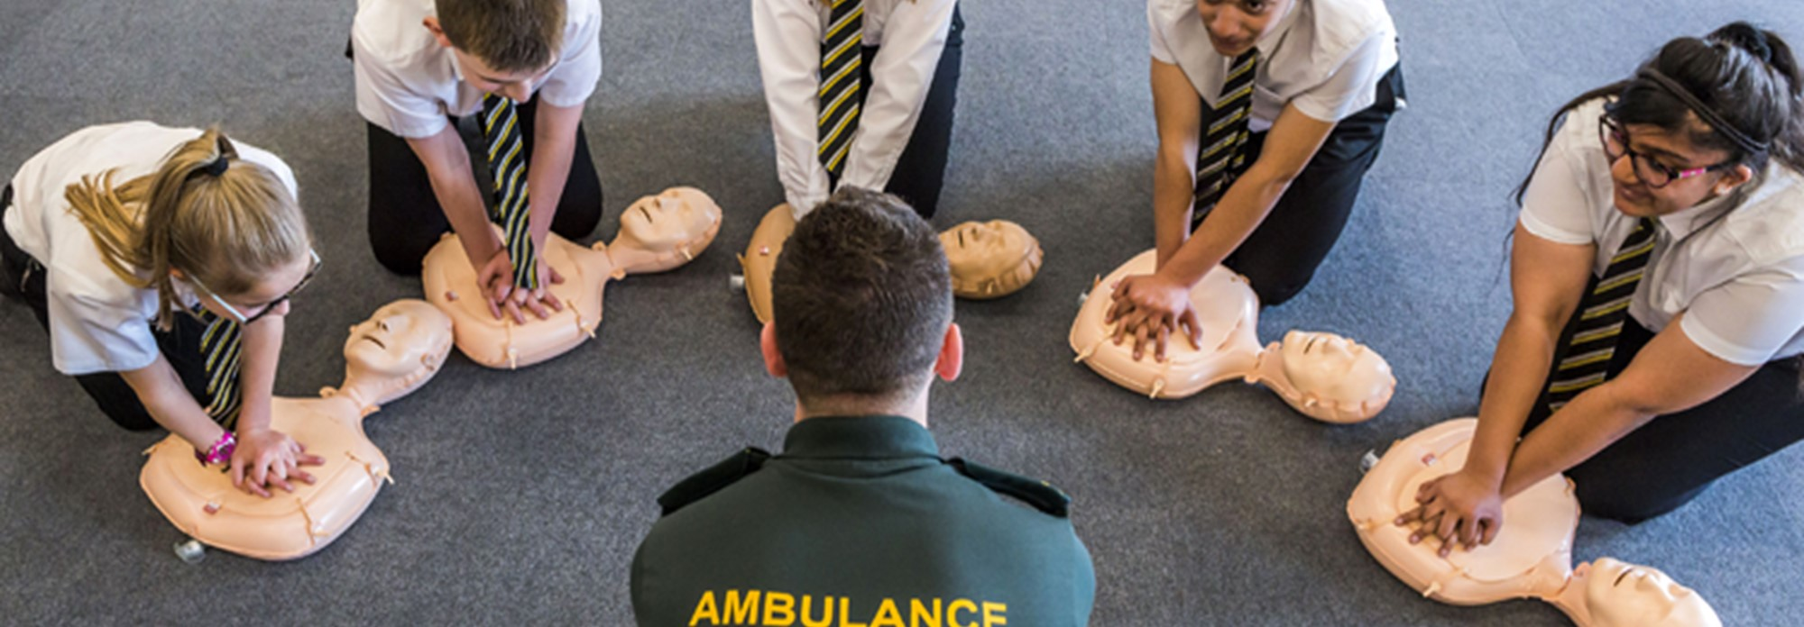
Over to you!

Slide 11
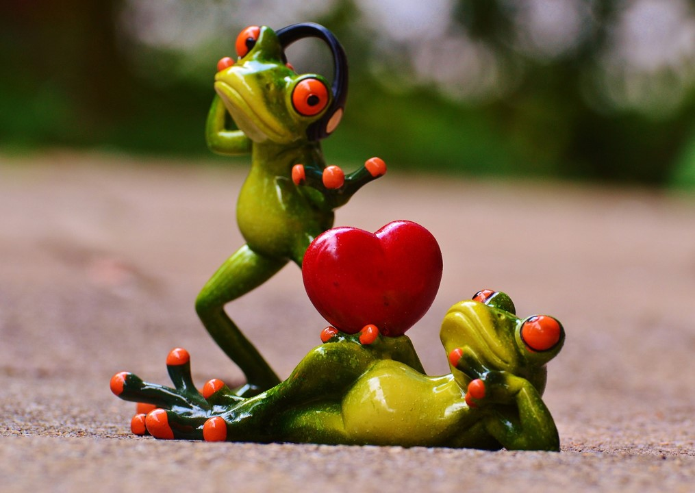
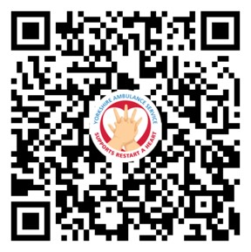
CPR playlist
Did you know that there is a playlist on Spotify of songs with the correct rate to perform CPR to?
Notes:
There are many songs out there that have the correct beat to enable us to do CPR to the right rhythm. Does anyone know of a song?

Slide 12
Myth busting
I will be sued if I do something wrong though won’t I?
I could make the situation worse.
Notes:
Some people are scared to perform CPR because they think they may hurt the person who needs treatment or be sued for their actions. But there is no need to be concerned. There has never been a case in the UK of someone facing legal action for performing CPR on a casualty. No-one should be criticised for trying to save a life.
Some people are afraid of performing CPR for fear of worsening the situation but if the patient does not receive CPR there is a good chance that they will die. On occasion, when performing chest compressions it is possible that ribs may be heard to crack, this is normal and not something to worry about.

Slide 13
Key messages
Approximately 80% of out of hospital cardiac arrests happen in the home so by learning CPR, you are gaining skills that could save the life of a family member or friend. 20% will occur in public places.
80%
If a defibrillator is used and effective CPR is performed within 3-5 minutes of a cardiac arrest, the patient’s chance of survival increases from 6% to 74%.

Slide 14
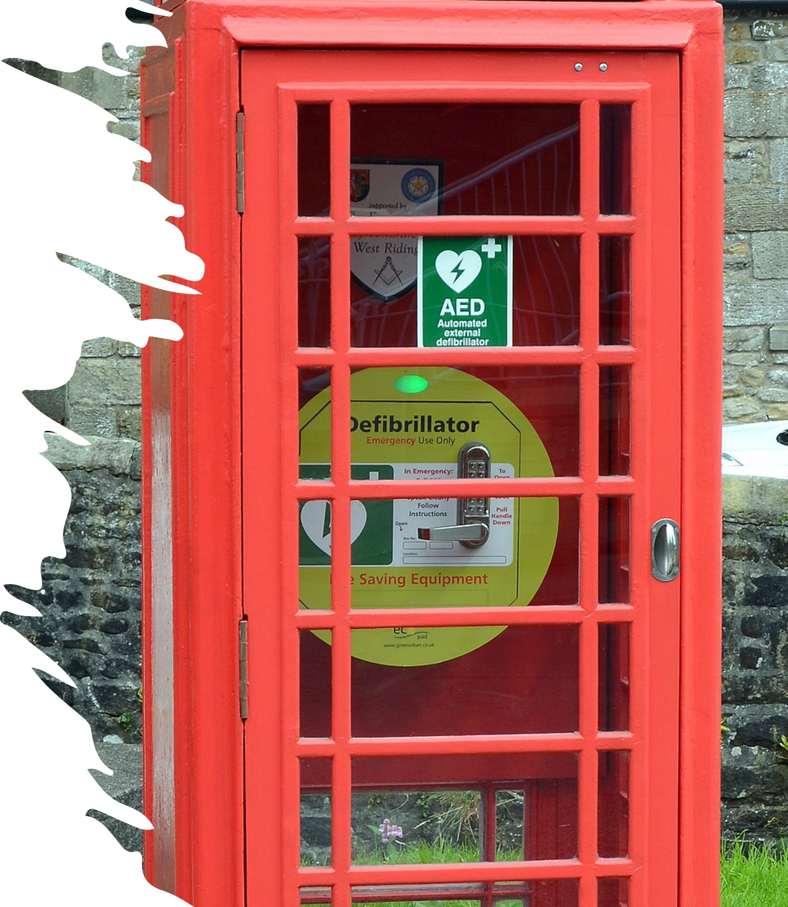
Defibrillators
Defibrillators give a high energy electric shock to the heart of someone who has suffered a cardiac arrest to restore the heart’s normal rhythm.
Combined with CPR, defibrillators give cardiac arrest patients the best possible chance of survival.
The devices are easy to use, provide audible instructions to the user and will not deliver a shock unless it is required. No training is required to use the equipment.
Notes:
The location of defibrillators - often in yellow or green cabinets in public spaces - can sometimes be marked with a white heart on a green background, or they could just be mounted on a wall behind a bar, in gyms, leisure centres, offices, tourist information centres, schools, colleges, railway stations, restaurants - anywhere at all.
If someone has suffered a cardiac arrest and you need a defibrillator, staff in our Emergency Operations Centre can direct 999 callers to their nearest device and provide a code to the secure cabinet it’s contained in if necessary.

Slide 15
Defibrillator training video
Notes:
**OPTIONAL**
https://youtu.be/qHZfI39r7cs
6:50 length AED Video
Urdu, Punjabi, Arabic and Polish subtitled versions also available on the YAS Youtube channel

Slide 16
It only takes two hands to save a life

