Slide 1
Welcome to
Restart a Heart Day
16 October 2023

Slide 2
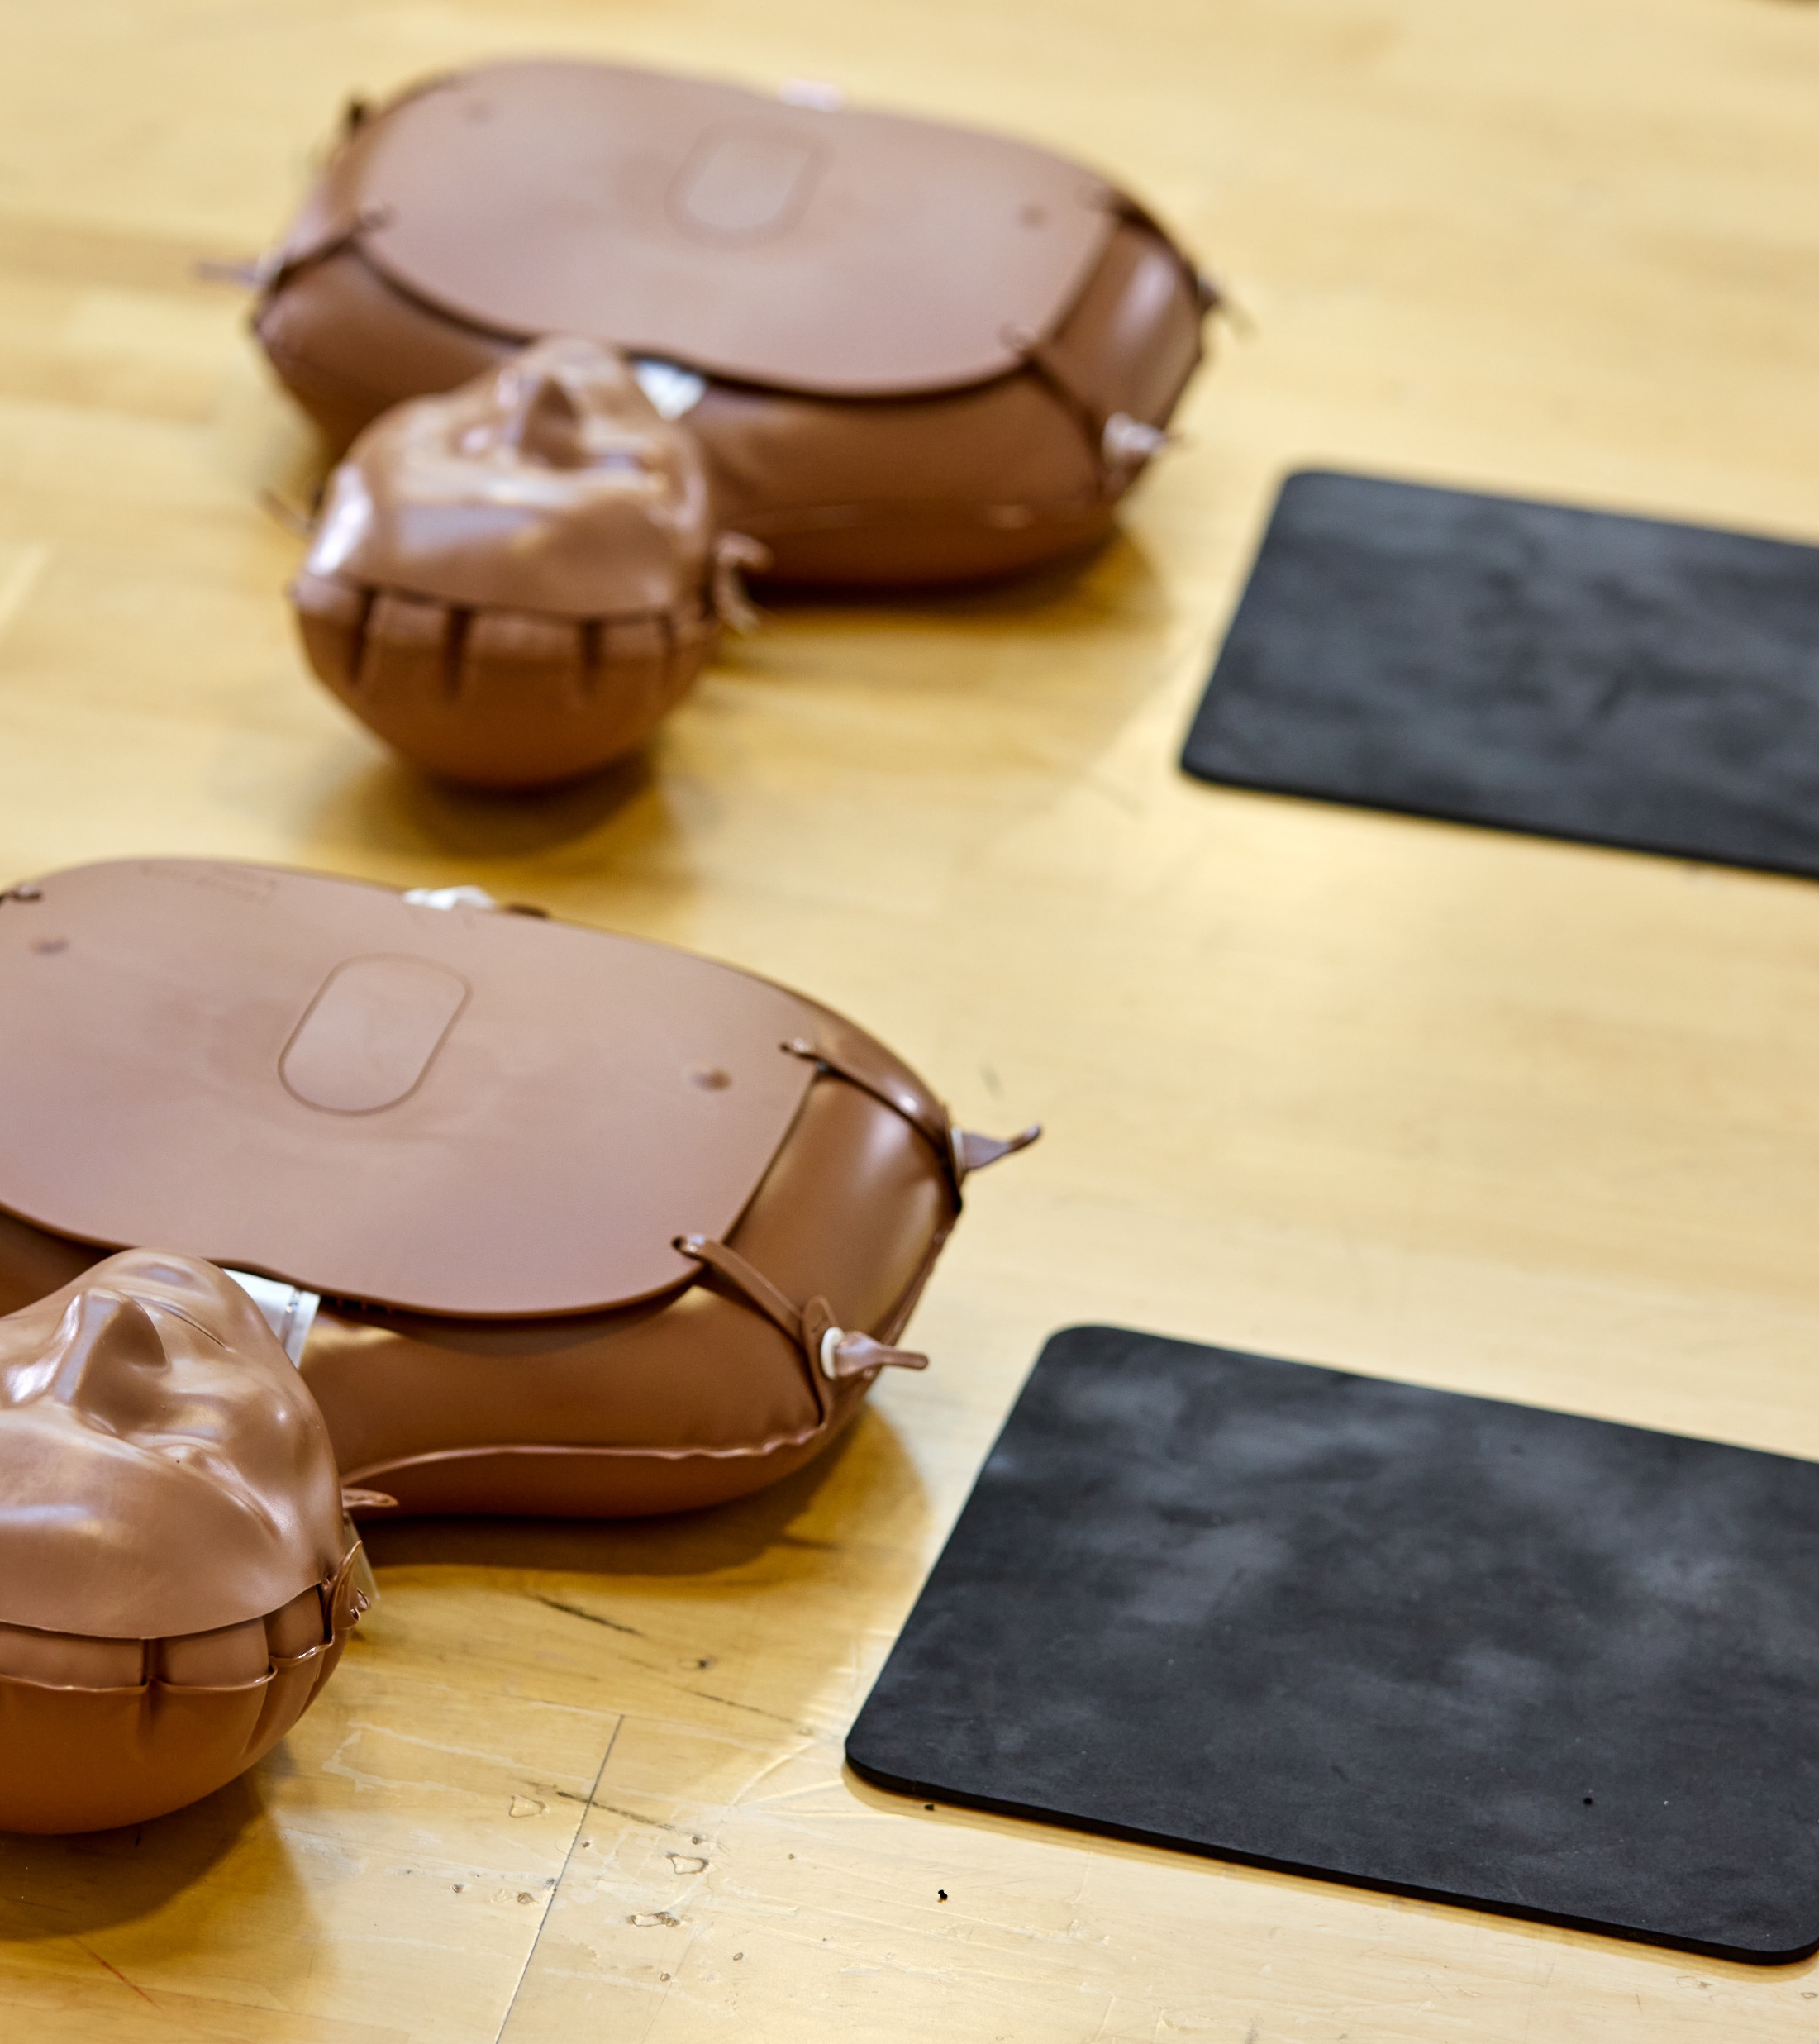
Welcome
Introductions – who are we and why are we here?
What is Restart a Heart Day and why is it important?

Slide 3
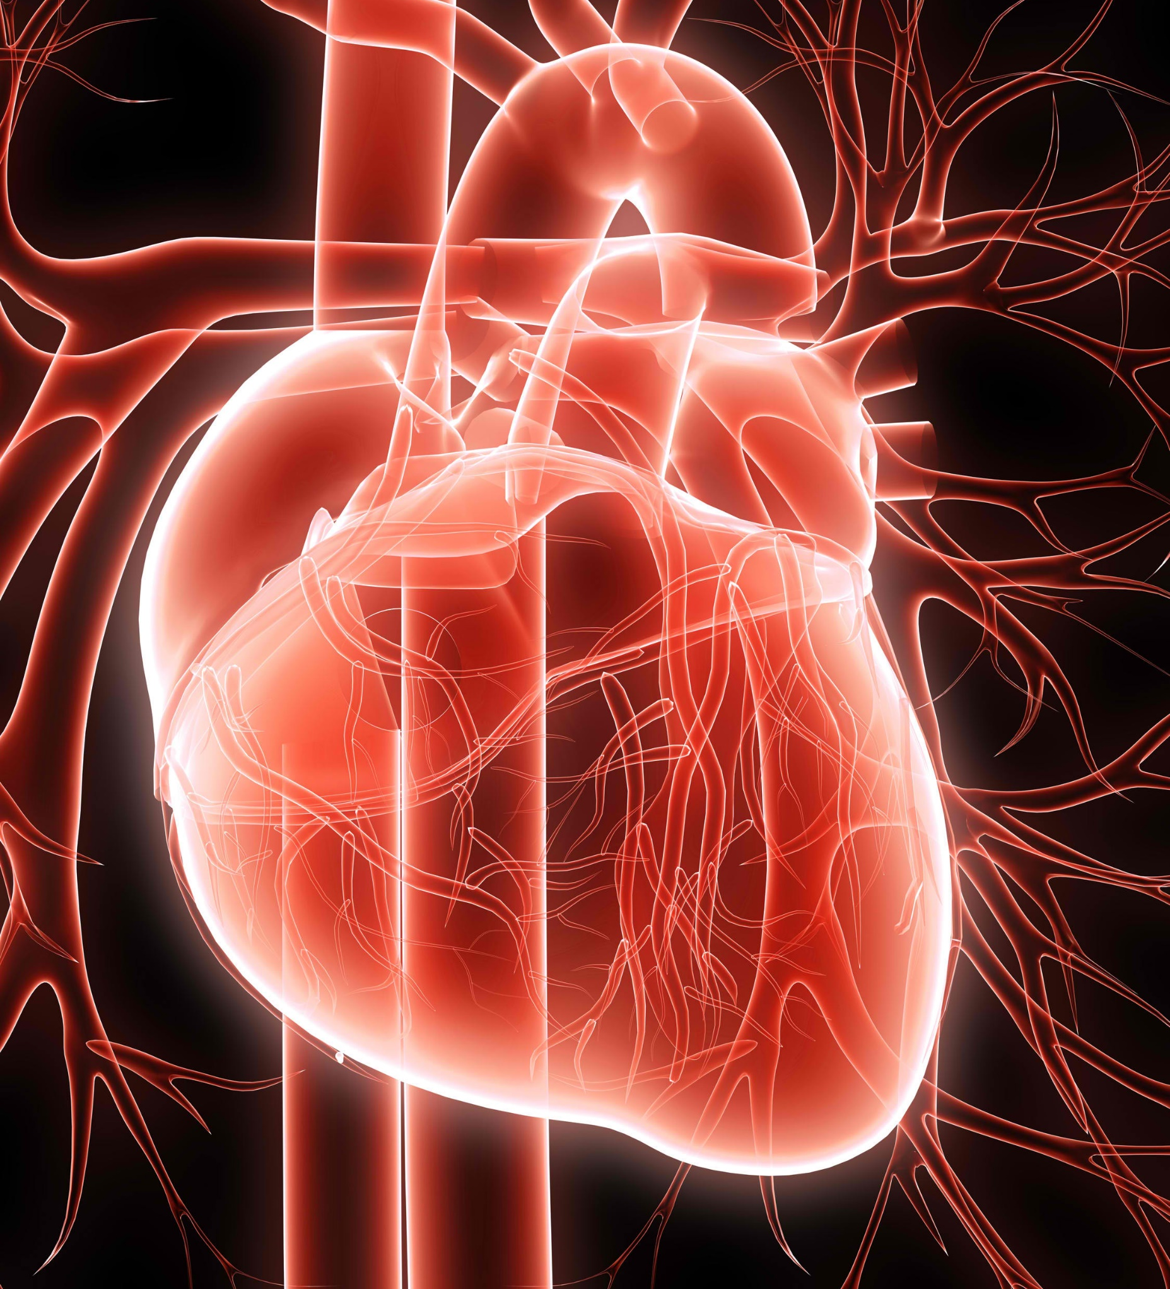
What is a cardiac arrest?
A cardiac arrest is the ultimate medical emergency when someone’s heart stops pumping blood around their body, causing them to collapse and stop breathing normally.
Every year about 30,000 people across the UK have a cardiac arrest outside of hospital.
About 1 in 10 of these patients survive their cardiac arrest but in countries where CPR is taught as part of the school curriculum it is as high as 4 in 10.
Notes:
If a cardiac arrest occurs, blood will stop circulating around the body. Breathing will also cease as well though it may not stop completely for several minutes. Without a supply of oxygen, the cells in the body start to die. Brain cells are incredibly sensitive. After about four or five minutes of no oxygen, brain cells will begin to die, leading to brain damage and death.
All the cells in your body require oxygen to survive. They also require a good supply of nutrients and the rapid removal of waste products. Oxygen and nutrients are carried around the body in your blood, which is pumped by your heart. In your lungs, oxygen enters your blood stream and carbon dioxide (a waste product) is removed in a process known as gas exchange. A cardiac arrest is when your heart stops beating. This is not the same as a heart attack, although a heart attack may lead to a cardiac arrest.

Slide 4
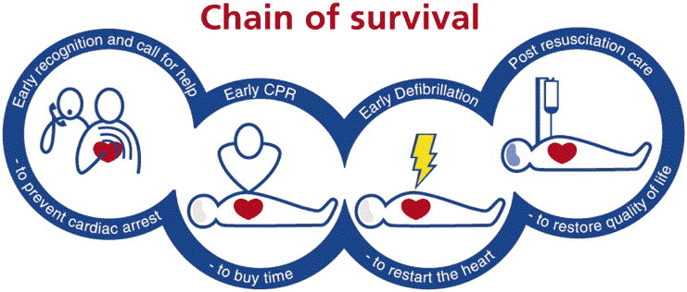
The Chain of Survival highlights the four essential steps needed to improve the chances of saving a life in an emergency.
Crucially, you must call 999 and ask for an ambulance straight away if someone is in cardiac arrest.
Notes:
Chain of Survival - Early Recognition, Early CPR, Early Call for Help, Early Defibrillation. A chain is only as strong as its weakest link. Bystander intervention is vital to improve outcomes.
Over 30,000 people suffer cardiac arrests outside hospital in the UK every year. If this happens in front of a bystander who starts CPR immediately before the arrival of the ambulance, the patient’s chances of survival double

Slide 5
What is CPR?
Cardiopulmonary resuscitation (CPR) is a simple life-saving technique given to someone in cardiac arrest. It aims to take over the job of the heart and lungs by keeping blood and oxygen flowing through the body.
By performing CPR, you can more than double someone’s chance of survival.
Chances of survival decrease by 10% for every minute that passes without CPR.

Slide 6
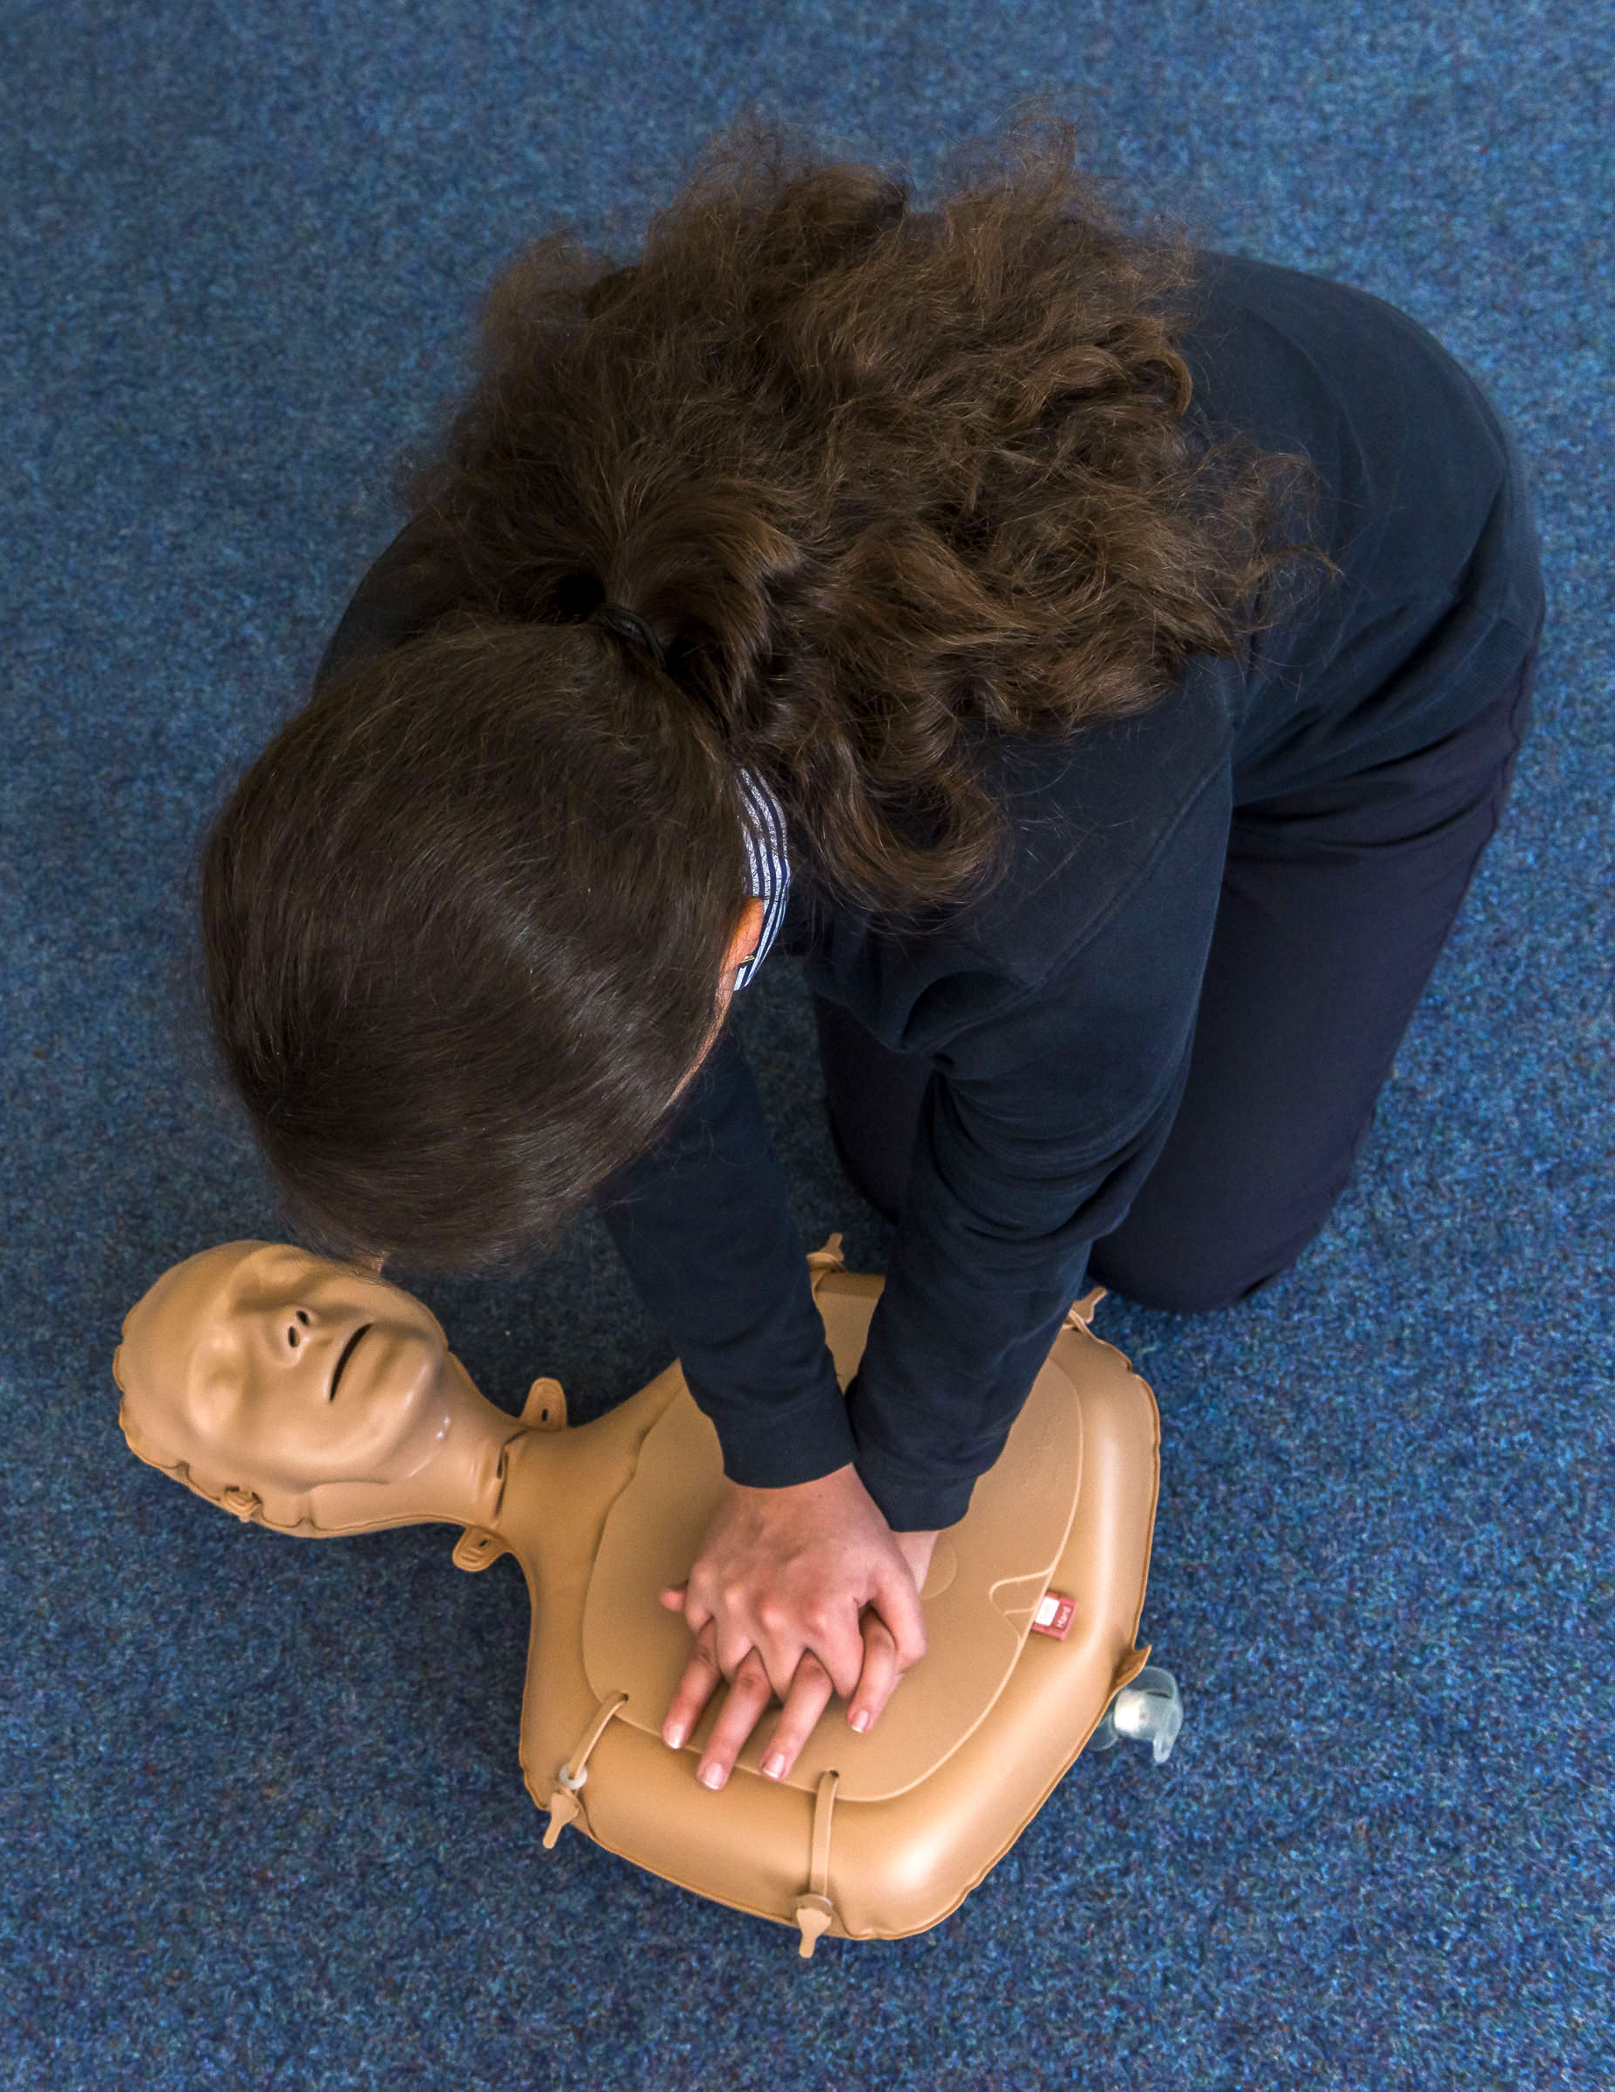
Hands-only CPR
Place the heel of your hand on the breastbone at the centre of the person's chest. Place your other hand on top of your first hand and interlock your fingers.
Position yourself with your shoulders above your hands. Using your body weight (not just your arms), press straight down by 5 to 6cm (2 to 2.5 inches) on their chest.
Keeping your hands on their chest, release the compression and allow the chest to return to its original position.
Repeat these compressions at a rate of 100 to 120 times a minute (or to the beat of Stayin’ Alive or Baby Shark) until an ambulance arrives, you become exhausted or the patient starts to show signs of regaining consciousness such as coughing, opening eyes, speaking or breathing.

Slide 7
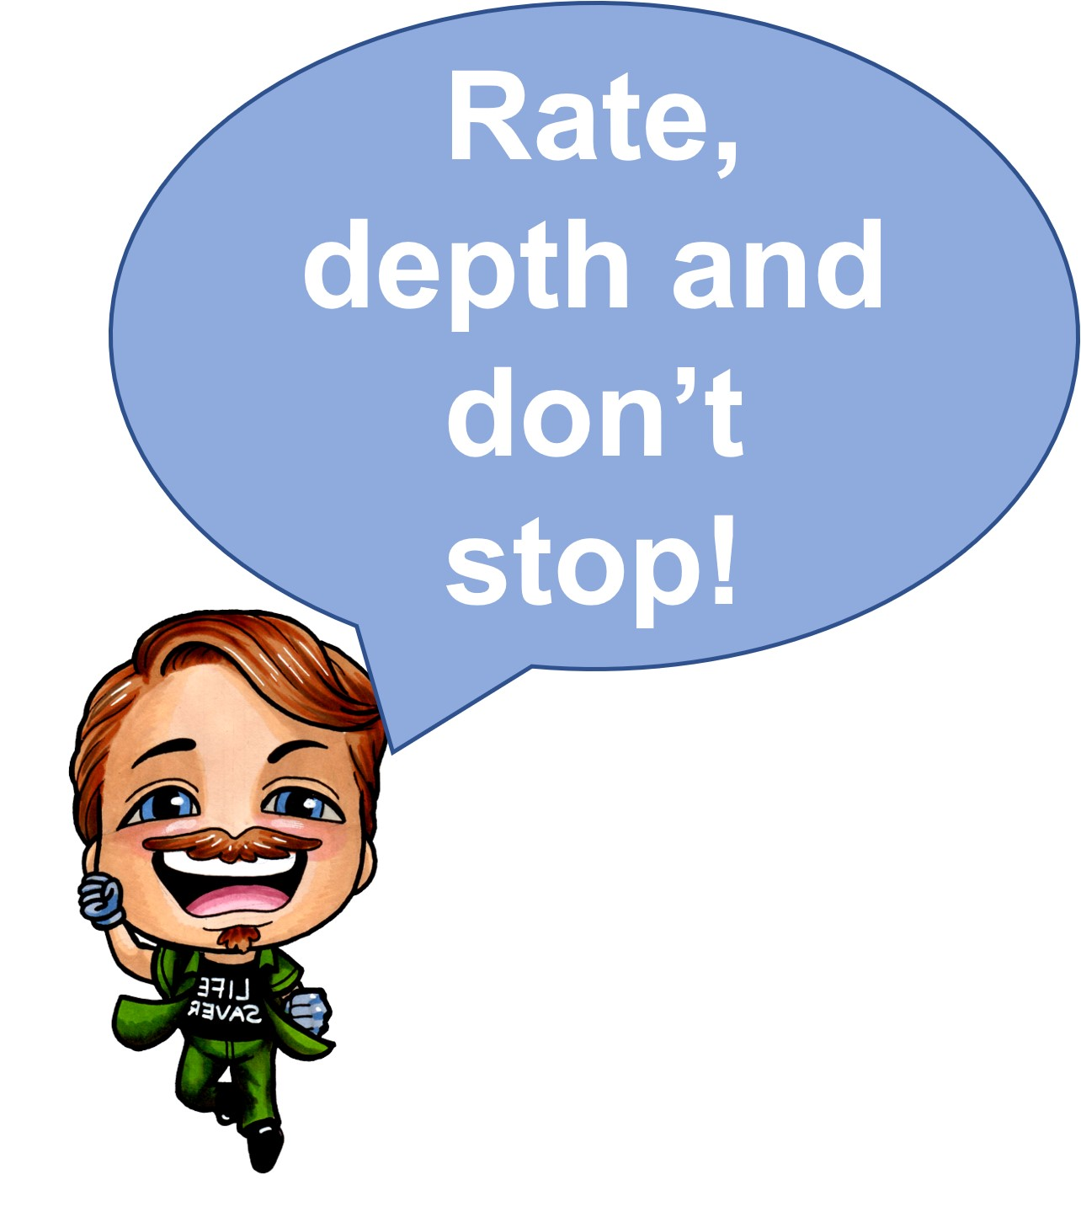
High quality CPR
To make sure your CPR is effective, remember the phrase ‘Rate, Depth and Don’t Stop’
Rate
Compressions at a rate of 100 to 120 per minute or two per second.
Depth
Compression depth of 5 to 6 centimetres.
Don’t stop
Limit any pauses to chest compressions.

Slide 8
CPR training video
Notes:
https://www.youtube.com/watch?v=YgQdVkFbQkk&t=147s
https://youtu.be/YgQdVkFbQkk
7:29 length CPR training video
Urdu, Punjabi, Arabic and Polish subtitled versions also available on the YAS Youtube channel

Slide 9
Over to you!

Slide 10
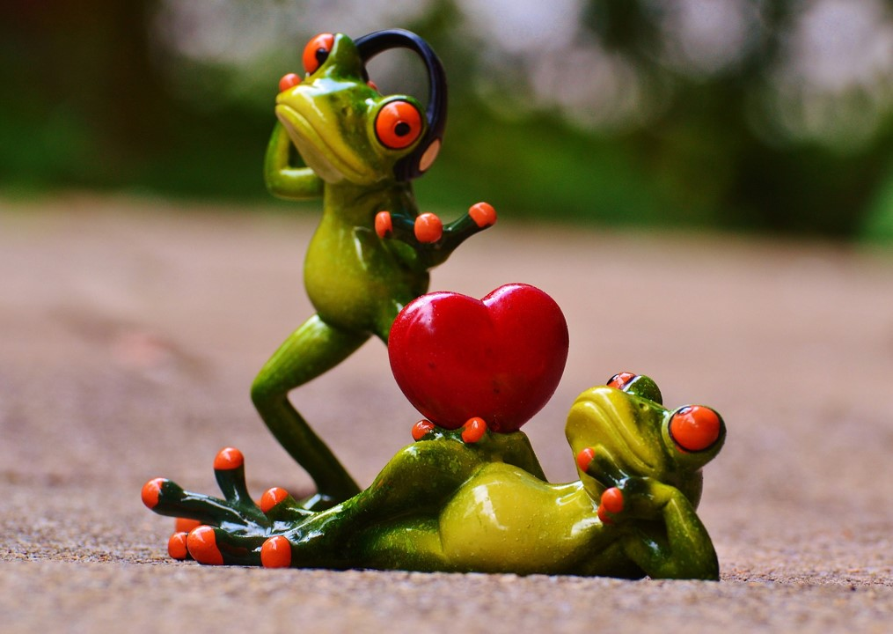
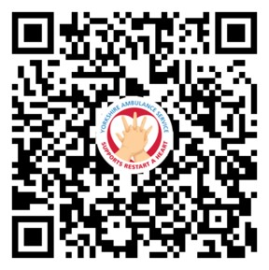
CPR playlist
Did you know that there is a playlist on Spotify of songs with the correct rate to perform CPR to?

Slide 11
Myth busting
I will be sued if I do something wrong though won’t I?
I could make the situation worse.
Notes:
Some people are scared to perform CPR because they think they may hurt the person who needs treatment or be sued for their actions. But there is no need to be concerned. There has never been a case in the UK of someone facing legal action for performing CPR on a casualty. No-one should be criticised for trying to save a life.
Some people are afraid of performing CPR for fear of worsening the situation but if the patient does not receive CPR there is a good chance that they will die. On occasion, when performing chest compressions it is possible that ribs may be heard to crack, this is normal and not something to worry about.

Slide 12
Key messages
Approximately 80% of out of hospital cardiac arrests happen in the home so by learning CPR, you are gaining skills that could save the life of a family member or friend. 20% will occur in public places.
80%
If a defibrillator is used and effective CPR is performed within 3-5 minutes of a cardiac arrest, the patient’s chance of survival increases from 6% to 74%.

Slide 13
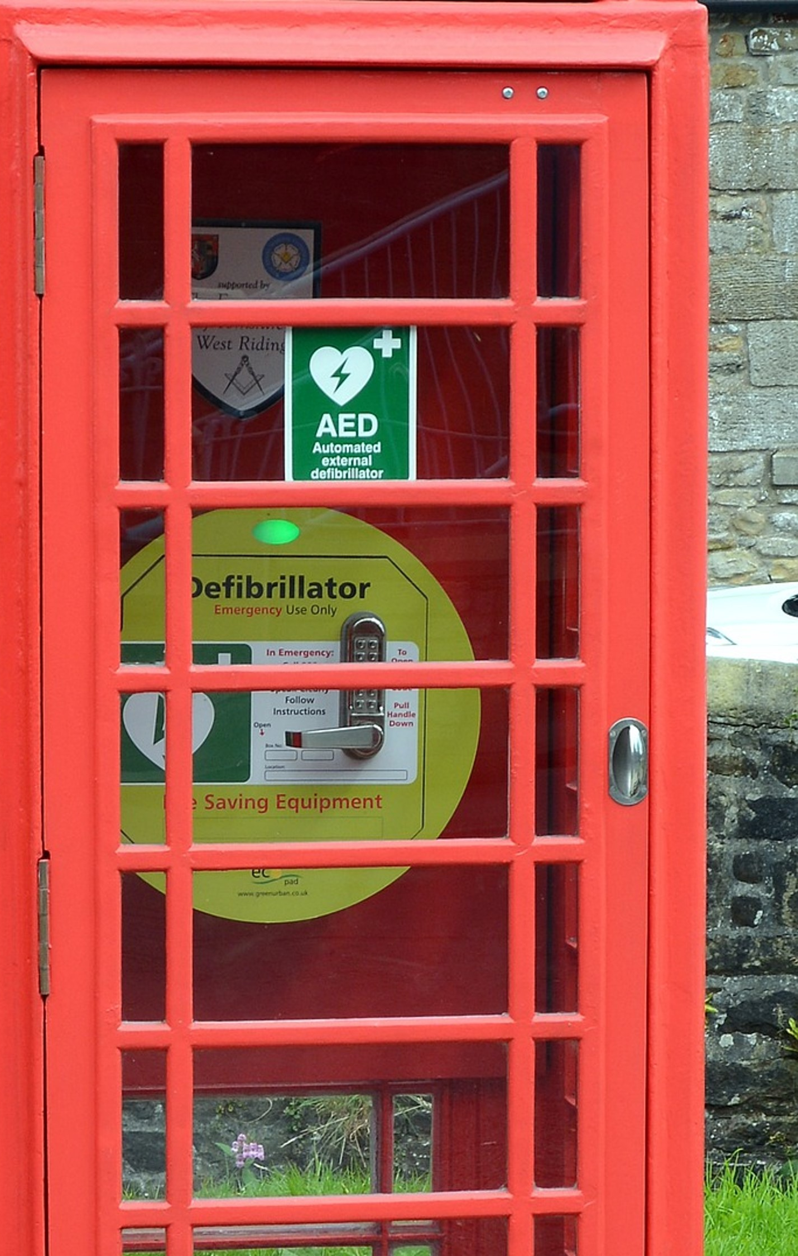
Defibrillators
Defibrillators give a high energy electric shock to the heart of someone who has suffered a cardiac arrest to restore the heart’s normal rhythm.
Combined with CPR, defibrillators give cardiac arrest patients the best possible chance of survival.
The devices are easy to use, provide audible instructions to the user and will not deliver a shock unless it is required. No training is required to use the equipment.
Where is your nearest defibrillator?

Slide 14
It only takes two hands to save a life

Slide 15
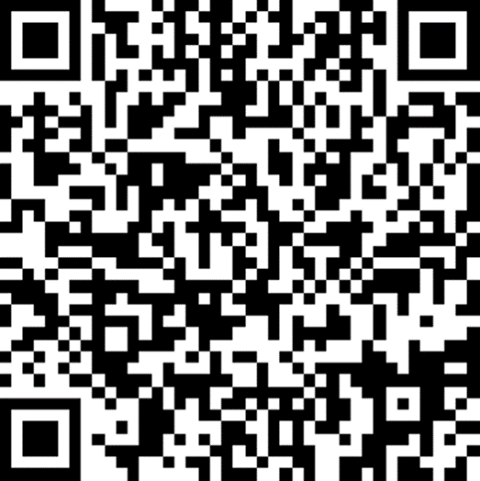
We want to hear from you!
Please take the time to complete a short survey so we can understand more about your CPR knowledge.
We would like all people who we train to complete this survey at:
https://www.surveymonkey.co.uk/r/KPYS68T
Thank you!

